Slide 3
Follow us on social media
https://www.facebook.com/GlobalOutreachDay
evangelismoglobal.gt@gmail.com
www.godecade.world

Slide 4
EVERYONE CAN
REACH OUT TO
SOMEONE.

Slide 7
DECADE OF EVANGELISM (GO DECADE) EXISTS TO HELP REACH THE WORLD TOGETHER.

Slide 8
IMAGINE WHAT COULD HAPPEN IN THE NEXT DECADE!

Slide 9
MAY 2024
WEEK 5
DISCIPLE
WEEK 4
PROCLAME
WEEK 3
SHARE
WEEK 2
ATTRACT
WEEK 1
PRAY AND GET READY
REST OF THE YEAR
WEEK 4
MAY 2024
WEEK 3
MAY 2024
WEEK 2
MAY 2024
WEEK 1
MAY 2024

Slide 10
JOIN THOUSANDS OF CHURCHES
and ministries around the world
AND dedicate the entire month of May 2024
to sharing
the Gospel of Jesus Christ

Slide 11
IMAGINE HOW THIS
will impact your neighborhood,
your city, your country
and the world!

Slide 13
Launch February 21
90 Days of Hope (June - August)
Witnessing Meetings
December: GO Christmas Evangelism (GO Christmas)
Decade of Evangelism Launch Meetings (1st, 2nd)
Expand, complete the national Global Evangelism Team
Continental Task Forces

Slide 14
THIS IS THE TIME!

Slide 15
Evangelism
TOOL
Dr. Milton Gay

Slide 16
LEMA
Train and involve the local church.
VISION
To advance the kingdom of God by preserving and propagating the gospel of Holiness.
MISION
Reach out to our communities proclaiming the message of salvation.
Evangelism
TOOL

Slide 17
ALPHA
A digital evangelistic tool, relational, dynamic, innovative, highly multiplicative and free.
It is easy to implement both online and in person.
Evangelism
TOOL

Slide 22
WITH
ALPHA
WE CAN ALL DO OUR PART IN BRINGING ANOTHER TO JESUS

Slide 23
What are the Alpha sessions like?
Alpha sessions are held once a week for 1 hour and 30 minutes.
The following three elements are present in each session
food
Video
discussion
Small group conversation
+ FUN

Slide 25
No two Alpha's are alike, but they all have these elements in common

Slide 26
FOOD
At the beginning of the session, it is a time to get to know each other better in the group.

Slide 27
ALPHA FOR TEENS
GAMES GUIDE
ALPHA FOR TEENS
GAMES GUIDE
ALPHA FOR TEENS
GAMES GUIDE
INDOOR
OUTDOOR
VIRTUAL
Available for download
FUN
Alpha with teenagers and young adults / can't miss

Slide 28
TALK
Videos of the series with 3 conversation breaks

Slide 29
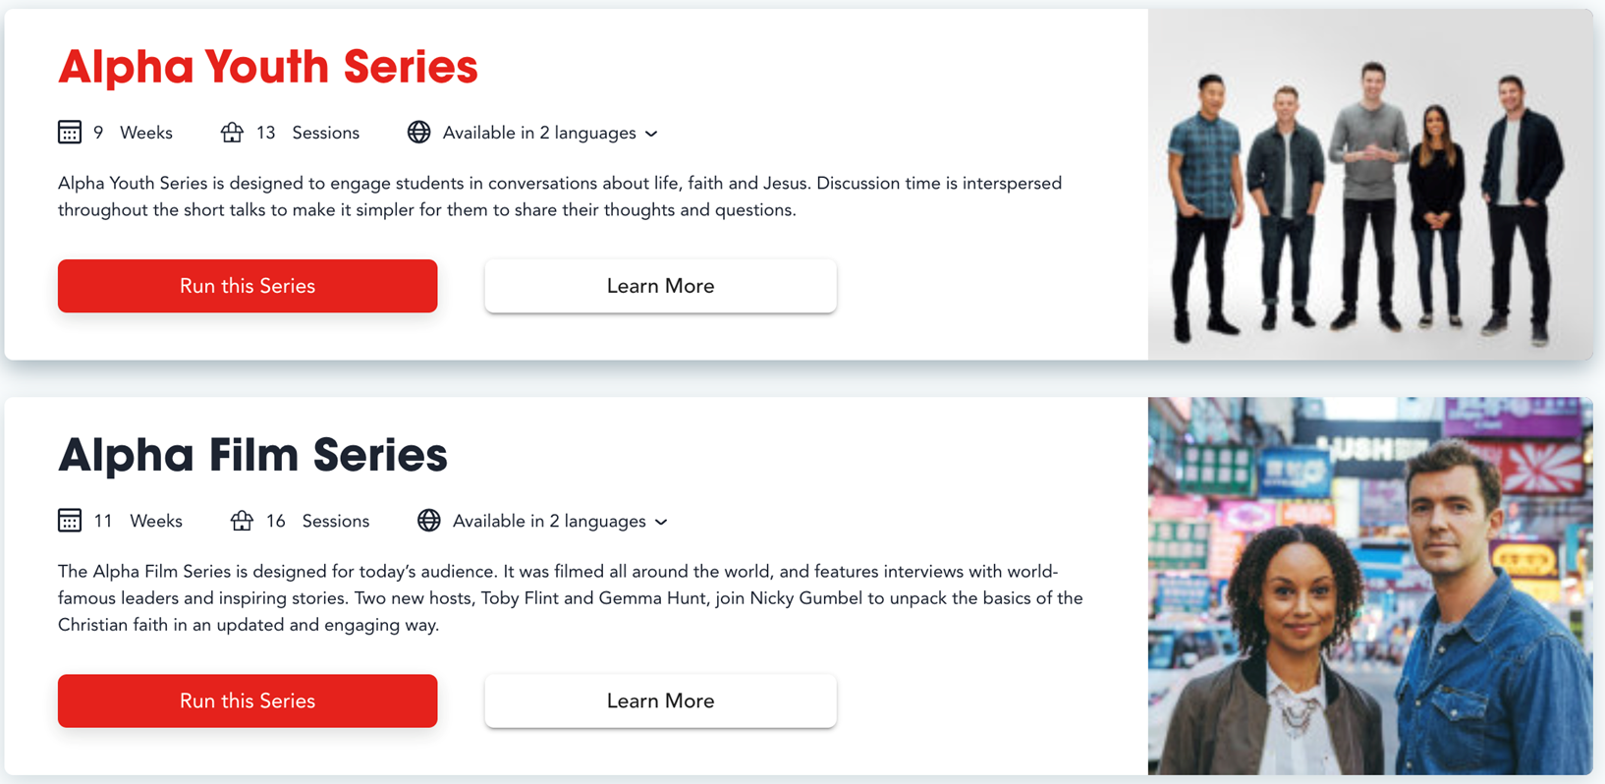
RESOURCES

Slide 30
OTHER RESOURCES

Slide 31
Prayer in Alpha
During the first 4 sessions we do not pray WITH the guests, but the hosts do pray FOR the guests.
We go from- to + / start praying in session 5.
In a simple and easy way, without using very religious language.
It has a special methodology / 3 moments for the Alpha day and on the theme: Healing.
In the learning center you will find videos to expand this information.

Slide 32
ALPHA
DAY
The themes dedicated to the Holy Spirit are developed on a special day, in a different place than where we regularly meet, it can be on a weekend or Alpha Day that combines recreation, teaching, conversation and prayer.
On the page you will find a training video on Alpha Day.

Slide 33
The church leader must be involved with your support for Alpha to serve as a gateway.
Register your Alpha in My Alpha
Steps to organize Alpha
Assemble a team of hosts and helpers and other tasks.
Get trained online or in the My Alpha Training Center
Invite
Start your Alpha
Take a photo

Slide 34
How to obtain Alpha's resources?

Slide 35
LOG IN TO

Slide 36
STEPS
CREATE AN ACCOUNT
Register with your name and passwor.
You will receive a confirmation email.
Check your inbox for spam or junk mail.
REGISTER THE CHURCH
CREATE AN ACCOUNT
What is the name of the church/organization related to the course?
Look it up in the list or create it.
dentify it well with name, city, country, as many have similar names.
Only one person per church should register and once you have access, invite the host team to join.
Create a course by answering 7 questions and give it a name.

Slide 37
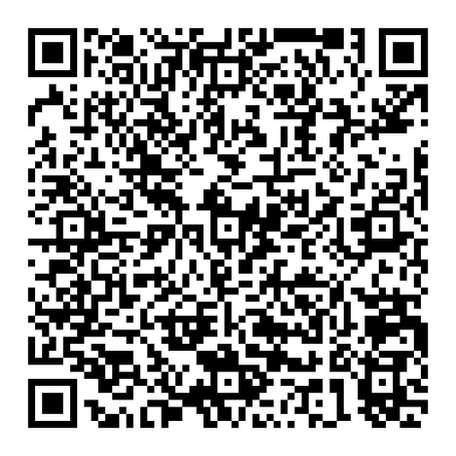
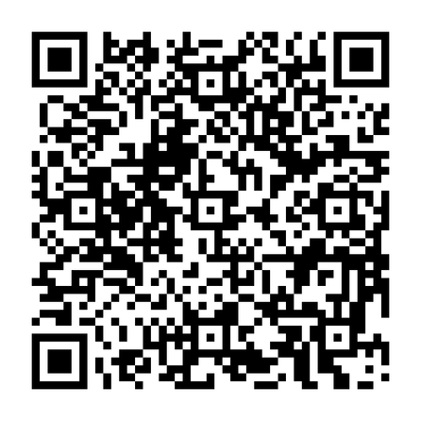
JESUS FILM
Evangelism
TOOL

Slide 38
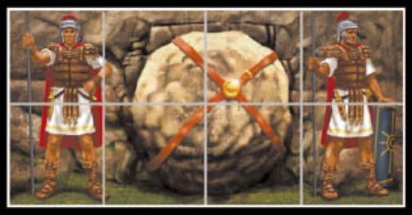
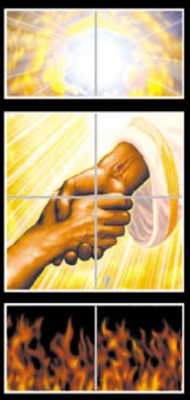
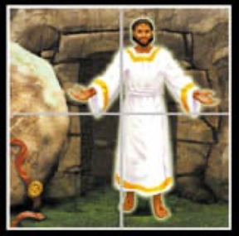
EVANGELISTIC CUBE
Evangelism
TOOL
GOD LOVES YOU +
You are a sinner
JESUS DIED FOR YOUR SINS
HE WAS BURIED
GOD RAISED JESUS FROM THE DEAD
JESUS IS THE ONLY WAY TO GOD
BELIEVE IN HIM AS YOUR SAVIOR

Slide 39
EVANGELISTIC BALL
BLACK
Sin and separation with God
RED
God's love shown in Jesus' cross
WHITE
God's forgiveness cleansing for us
GREEN
The Growth of the children of God through spiritual disciplines
YELLOW
The promise of eternal life with God in heaven

Slide 40
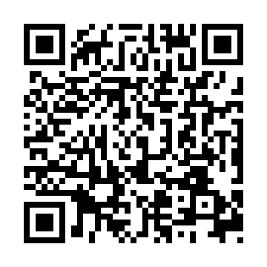
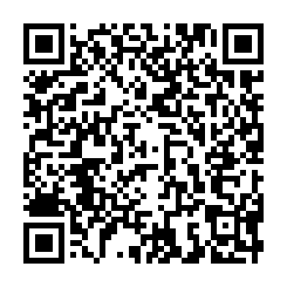

Slide 41
THE FOUR
CONNECTION WITH THE LOST (JOHN 4: 7-15)

Slide 42
THESE FOUR SYMBOLS REPRESENT THE CENTRAL MESSAGE OF THE BIBLE
God loves you
totally!
His love is unlimited
and unconditional.
Genesis 1:31
Doing things our own way is what the Bible calls sin
Romans 3:23
Our sin does not prevent God from loving us!
On the cross, Jesus took the punishment for our sins
John 3:16
DECISION
He offers us a full and eternal life through Jesus Christ. Each person is challenged to make a decision.
John 1:12

Slide 43
THESE FOUR SYMBOLS REPRESENT THE CENTRAL MESSAGE OF THE BIBLE
God loves you
totally!
His love is unlimited
and unconditional.
Genesis 1:31
Our sin does not prevent God from loving us!
On the cross, Jesus took the punishment for our sins
John 3:16
DECISION
He offers us a full and eternal life through Jesus Christ. Each person is challenged to make a decision.
John 1:12
Doing things our own way is what the Bible calls sin
Romans 3:23

Slide 44
THESE FOUR SYMBOLS REPRESENT THE CENTRAL MESSAGE OF THE BIBLE
Doing things our own way is what the Bible calls sin
Romans 3:23
God loves you
totally!
His love is unlimited
and unconditional.
Genesis 1:31
Our sin does not prevent God from loving us!
On the cross, Jesus took the punishment for our sins
John 3:16
DECISION
He offers us a full and eternal life through Jesus Christ. Each person is challenged to make a decision.
John 1:12

Slide 45
THESE FOUR SYMBOLS REPRESENT THE CENTRAL MESSAGE OF THE BIBLE
Our sin does not prevent God from loving us!
On the cross, Jesus took the punishment for our sins
John 3:16
God loves you
totally!
His love is unlimited
and unconditional.
Genesis 1:31
Doing things our own way is what the Bible calls sin
Romans 3:23
DECISION
He offers us a full and eternal life through Jesus Christ. Each person is challenged to make a decision.
John 1:12

Slide 46
THESE FOUR SYMBOLS REPRESENT THE CENTRAL MESSAGE OF THE BIBLE
DECISION
He offers us a full and eternal life through Jesus Christ. Each person is challenged to make a decision.
John 1:12
God loves you
totally!
His love is unlimited
and unconditional.
Genesis 1:31
Doing things our own way is what the Bible calls sin
Romans 3:23
Our sin does not prevent God from loving us!
On the cross, Jesus took the punishment for our sins
John 3:16

Slide 47
GOD
MAN
CHRIST
THE GOSPEL
with the hands
FAITH
GRACE

Slide 48
THE GOSPEL
with the hands
S
ETERNAL LIFE IS A GIFT AND THEREFORE CANNOT BE EARNED OR DESERVED.
Romans 6:23
Ephesians 2:8-9
GRACE

Slide 49
MAN
MANKIND IS SINFUL. IT CANNOT SAVE ITSELF.
Romans 3:23
Matthew 5:48
THE GOSPEL
with the hands

Slide 50
GOD
GOD IS MERCIFUL, BUT HE IS ALSO JUST.
1 John 4:8
Exodus 34:7b
THE GOSPEL
with the hands

Slide 51
CHRIST
THE GOSPEL
with the hands
HE DIED ON THE CROSS, ROSE FROM THE DEAD TO PAY FOR OUR SINS.
JOHN 1:1 AND 14
ISAIAH 53:6

Slide 52
SAVING FAITH IS NOT MERE INTELLECTUAL KNOWLEDGE, NOR IS IT TEMPORAL FAITH. SAVING FAITH IS BY TRUSTING IN JESUS CHRIST ALONE FOR ETERNAL LIFE.
James 2:19
Acts 16:31
THE GOSPEL
with the hands
FAITH

Slide 53
THREE THIRDS
A Discipleship Formation Process

Slide 54
OVERVIEW
LOOKING BACK
LOOKING UP
LOOKING FORWARD
Careful "How are you?”
Worship
Celebrating Loyalty - Accountability & Review
Fostering Vision & Encouragement - Vision
New Lesson Obedience-Based Bible Study (Biblical Content that leads to obedience)
Preparing for the Mission. Practice. Confidence to obey and train others.
Mission Achievement Applications Goal setting
Praying for Mission

Slide 55
LOOKING BACK
Care "How are you?"- worship- Celebrating Fidelity - Accountability & Review - Encouraging Vision & Encouragement - Vision
ORIGINAL
RED PARTS ARE IMPORTANT FOR MULTIPLICATION.
Asking questions "How are you? How was your week'?" Celebrating Loyalty - How did you achieve your commitments last week? - Encourage Vision & Encouragement - Vision Remind them of our goals and if one didn't make it encourage them to keep going and not give up.
EXAMPLE
GREEN PARTS ARE IMPORTANT FOR GROWTH AND HEALTH.
It will help the person think and reflect. "How do you feel?" Celebrating Fidelity - Tell me how you made it? - Encouraging Vision & Encouragement - What is the most rewarding thing you did?
ACCOMPANIMENT

Slide 56
LOOKING UP
New Lesson. Obedience Based Bible Study (Biblical content that leads to obedience).
ORIGINAL
GREEN PARTS ARE IMPORTANT FOR GROWTH AND HEALTH.
Mention what will be discussed today, based on obedience and biblical content."
EXAMPLE
Help the person think and reflect on the content given that day.
ACCOMPANIMENT

Slide 57
LOOKING FORWARD
Preparing for the Mission. Practice. Confidence to obey and train others - Applications to Achieve the Mission. Setting goals - Praying for the Mission
ORIGINAL
RED PARTS ARE IMPORTANT FOR MULTIPLICATION.
Ask what you will do in practice. According to the lessons; what will your goals be; what will you do; what will you implement from what you learned today?
EXAMPLE
GREEN PARTS ARE IMPORTANT FOR GROWTH AND HEALTH.
Help the person reflect on the future. Questions such as: How will you do it, what will you do, when will you do it, what is the next step you will take?
ACCOMPANIMENT

Slide 58
Strategy
PCS+M
Pray
+M
Share
Care

Slide 59
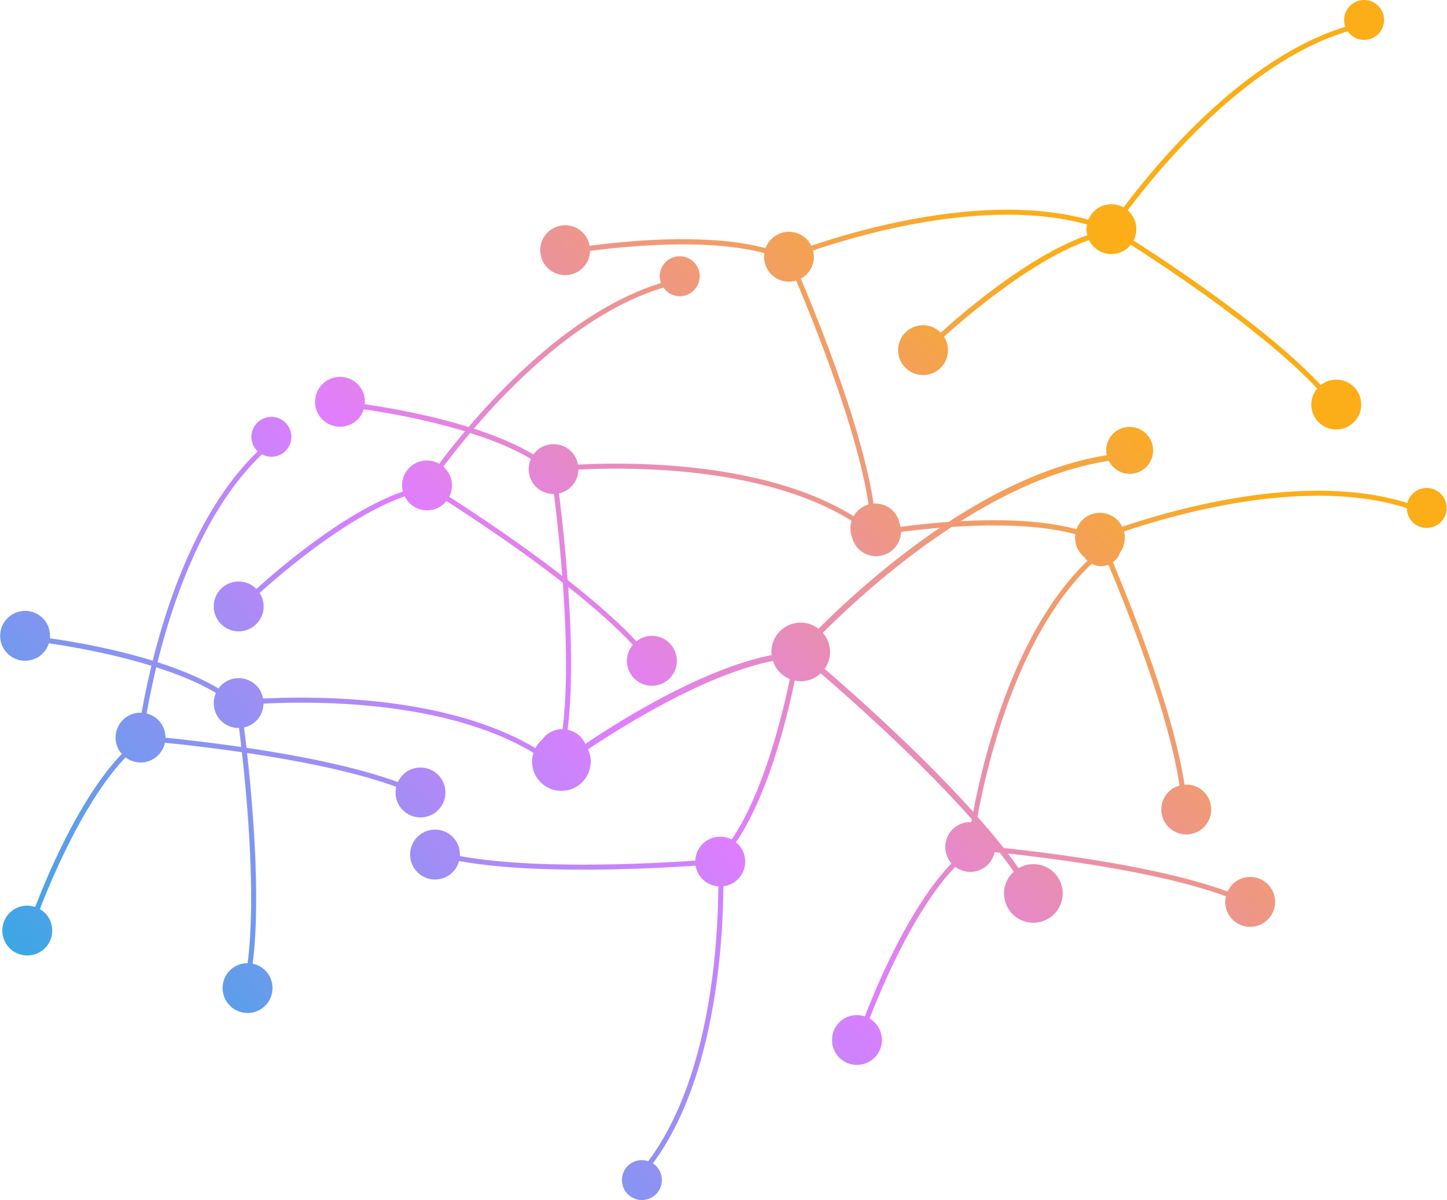
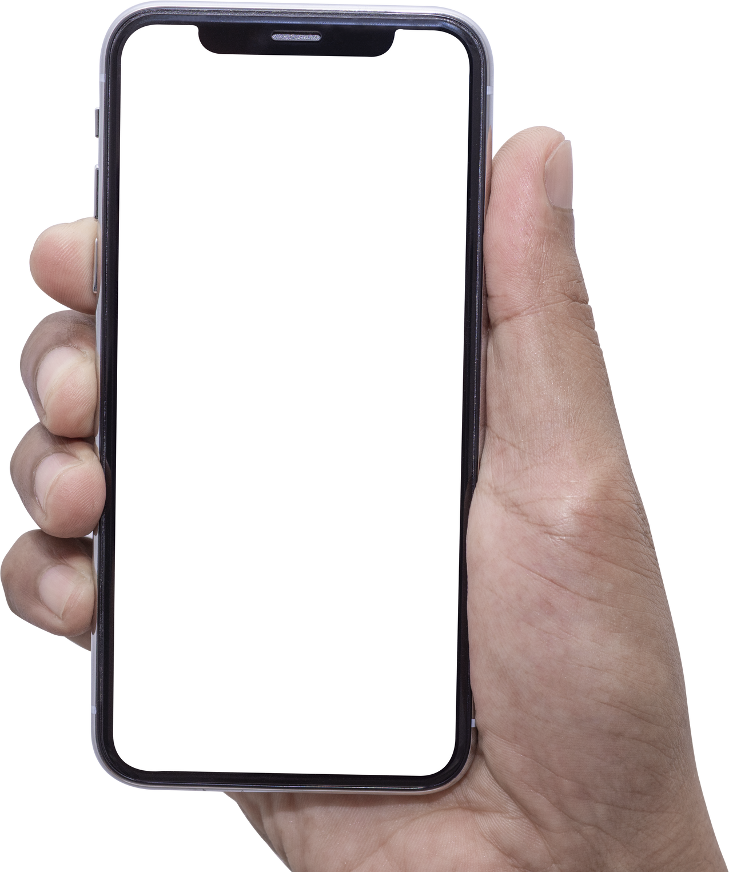
NETWORK
relational
Neighbors
Family
Work
University
School
Sport

Slide 60
PRAY
"Tell God about people before you tell people about God." - Bill Bright
Prepare our hearts to share the Gospel and also the heart of the unbeliever to receive it. Salvation is God's work in the heart of man.
Pray
+M
Share
Care

Slide 61
PRAY
Pray
Make a list
The amazing question
+M
Share
Care

Slide 62
PRAY
Together with the community you can PRAY
Pray
+M
Share
virtually go to their jobs to their homes, using the Google Earth application.
Care

Slide 63
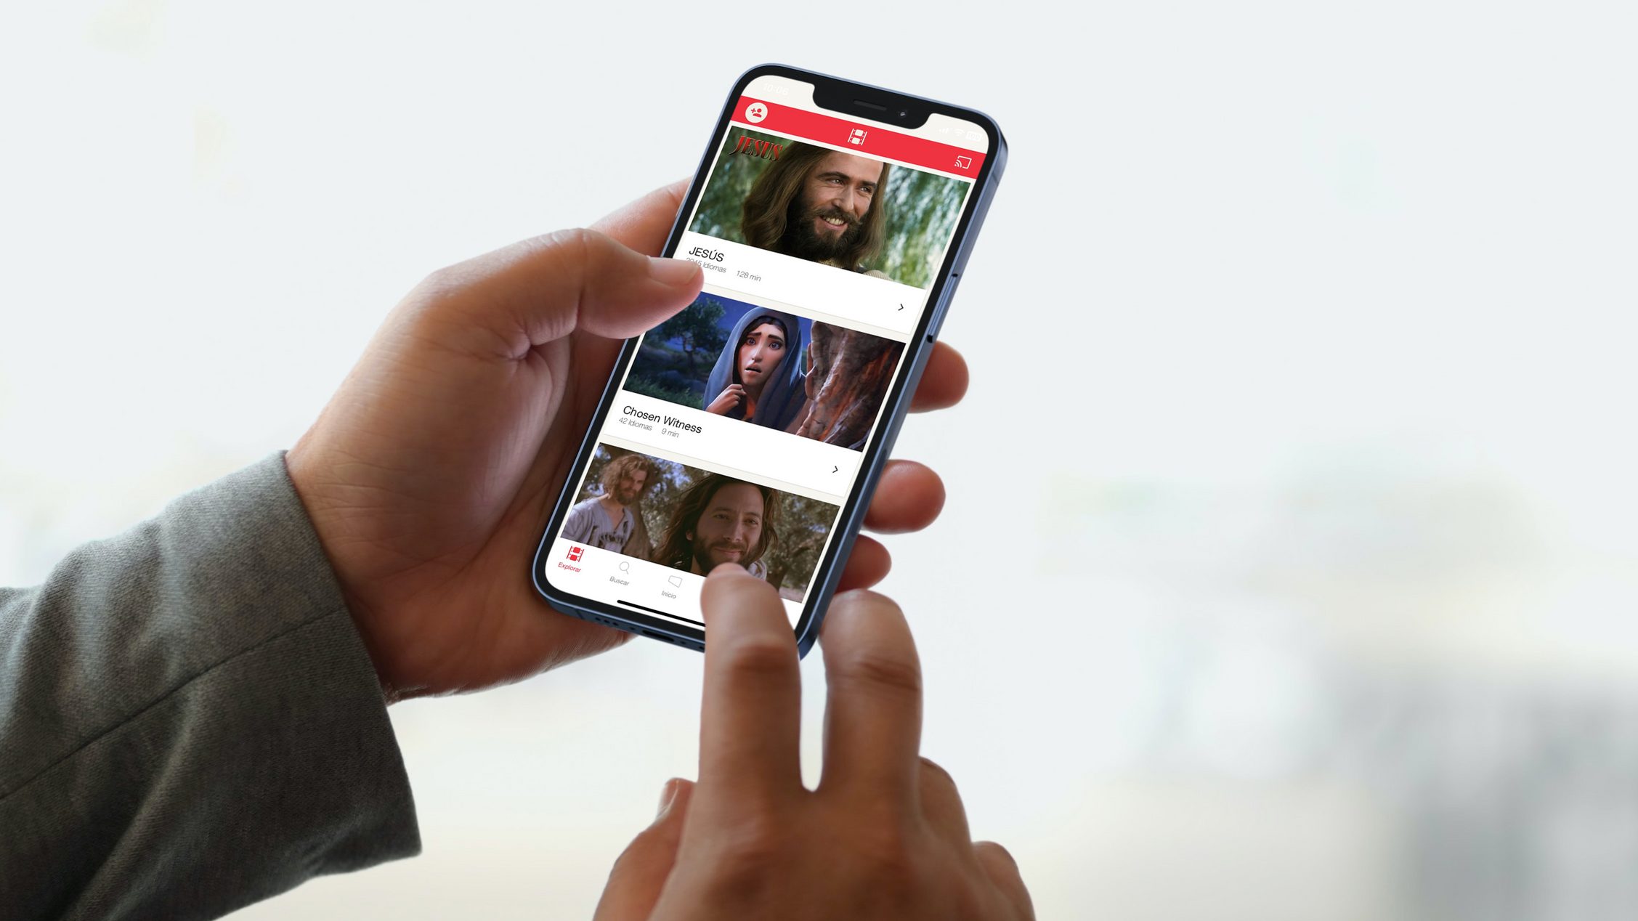
ALL
everywhere

Slide 64
JESUS FILM

Slide 65
CARE
Pray
+M
Share
Care
Serve people with acts of kindness and things they cannot do for themselves.
They may believe in God because of the fruit of showing them the love God has put in your heart for them.

Slide 66
Pray
PERSONAL TESTIMONY - GODTOOLS
+M
Share
Care
THE FOUR
SHARE

Slide 67
WRITE DOWN
the changes

Slide 68
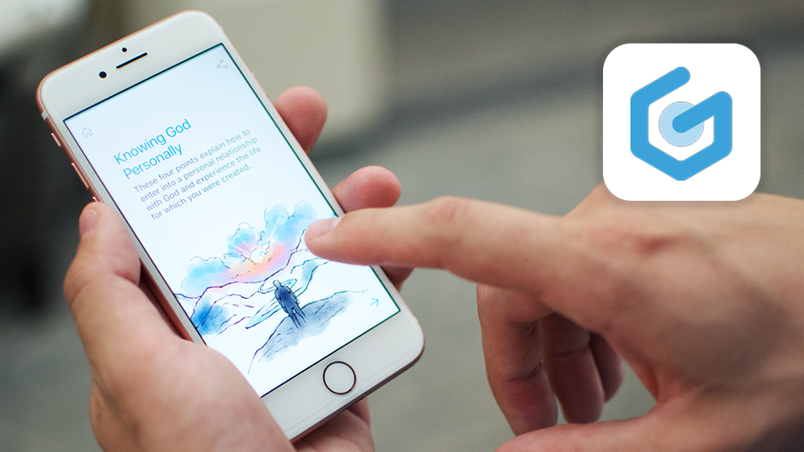

Slide 70
THE FOUR
CONNECTION WITH THE LOST (JOHN 4: 7-15)

Slide 71
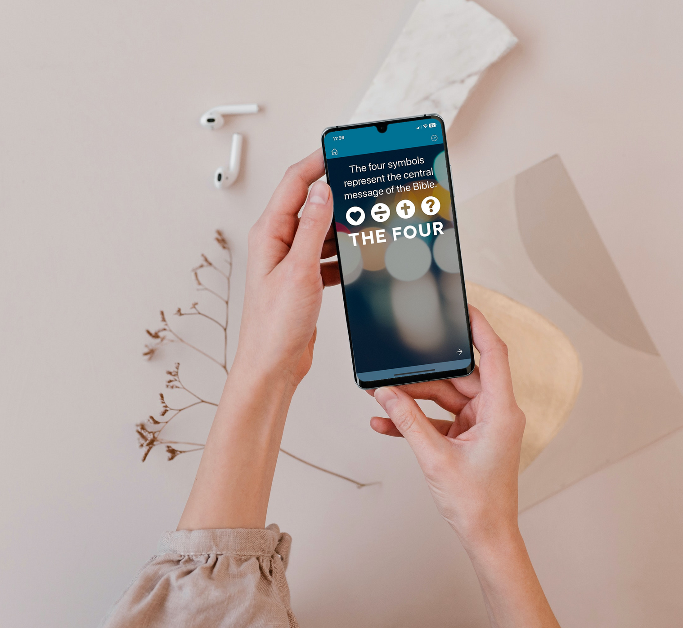
YOU ASK YOURSELF, HOW COULD YOU SHARE THE CHRISTIAN FAITH in a clear and simple way?

Slide 72
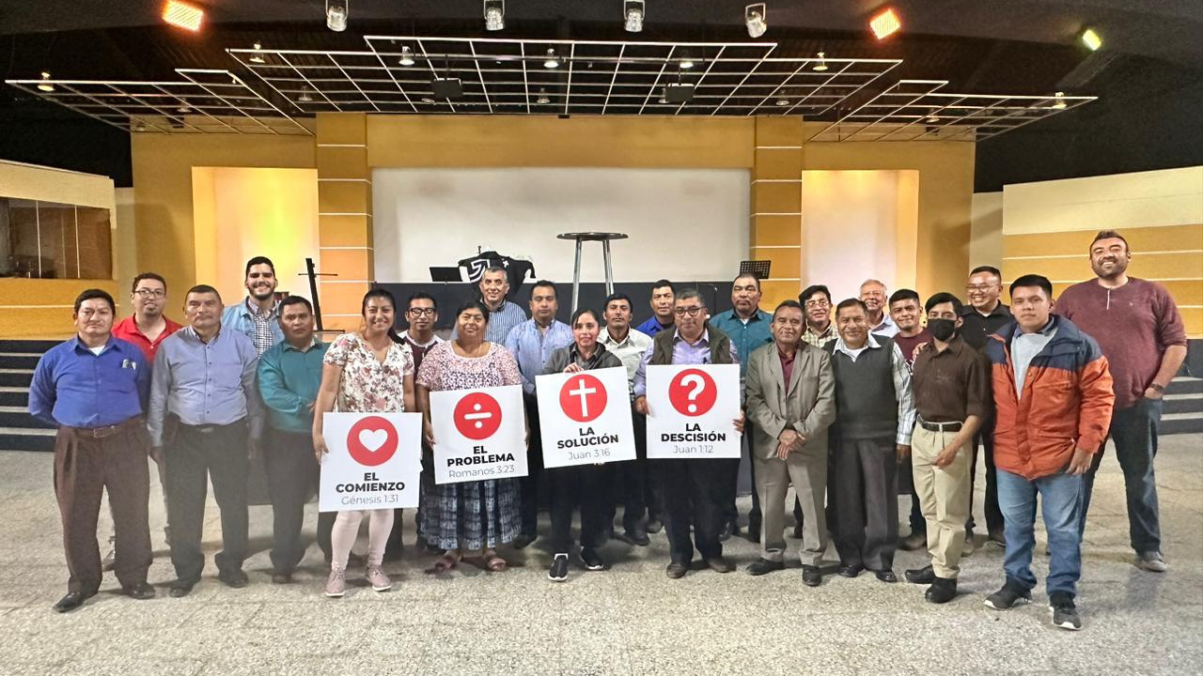
THESE FOUR SYMBOLS REPRESENT THE CENTRAL MESSAGE OF THE BIBLE

Slide 73
ADVANTAGES
Graphical simplicity / Innovative
Easy to use / Brings clarity to the message

Slide 74
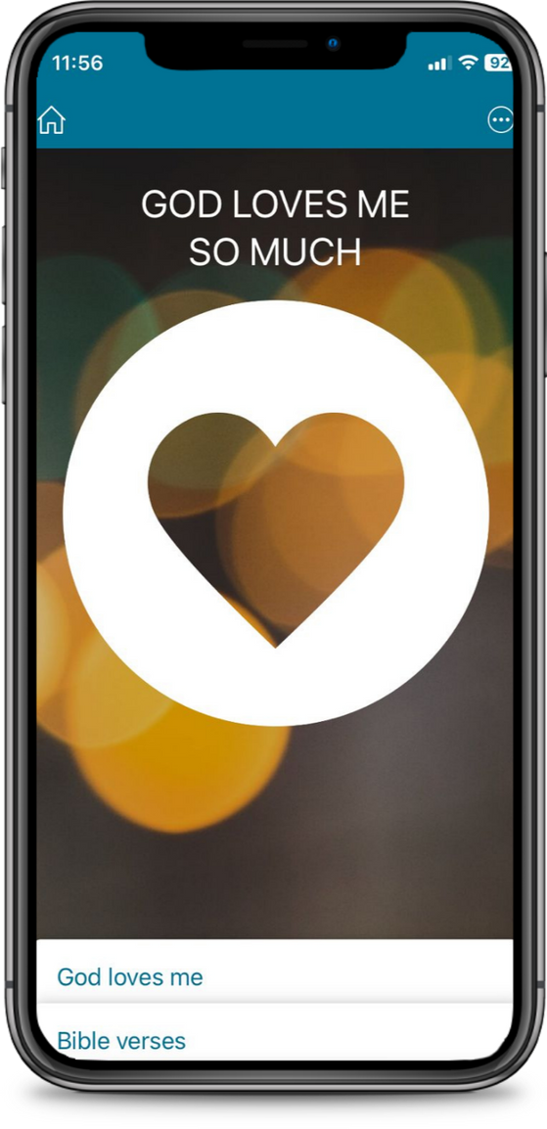
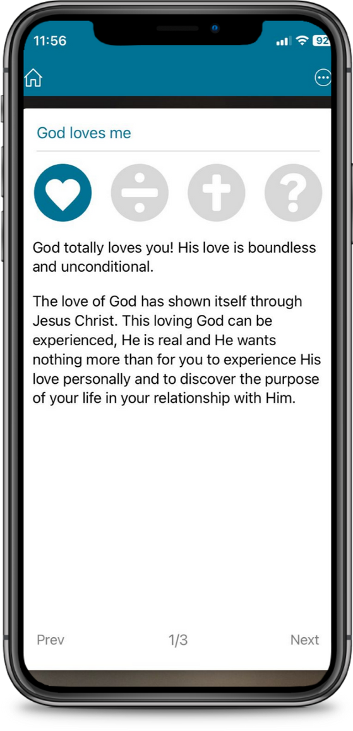
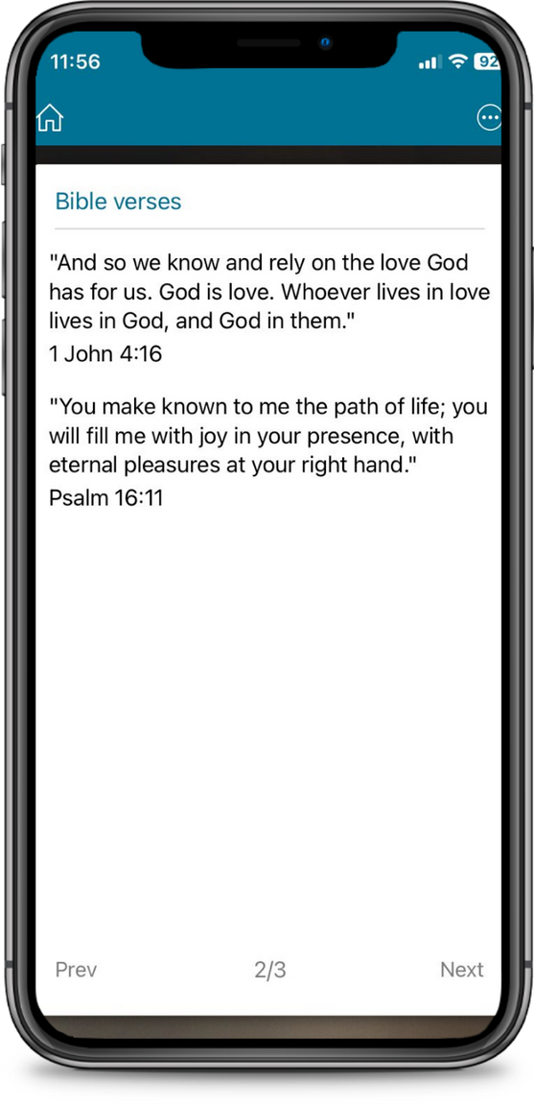
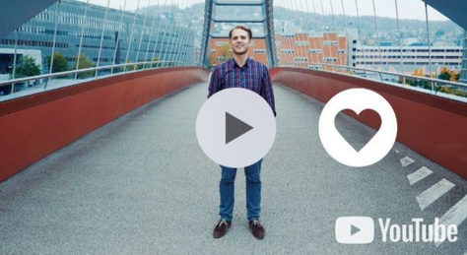

Slide 75
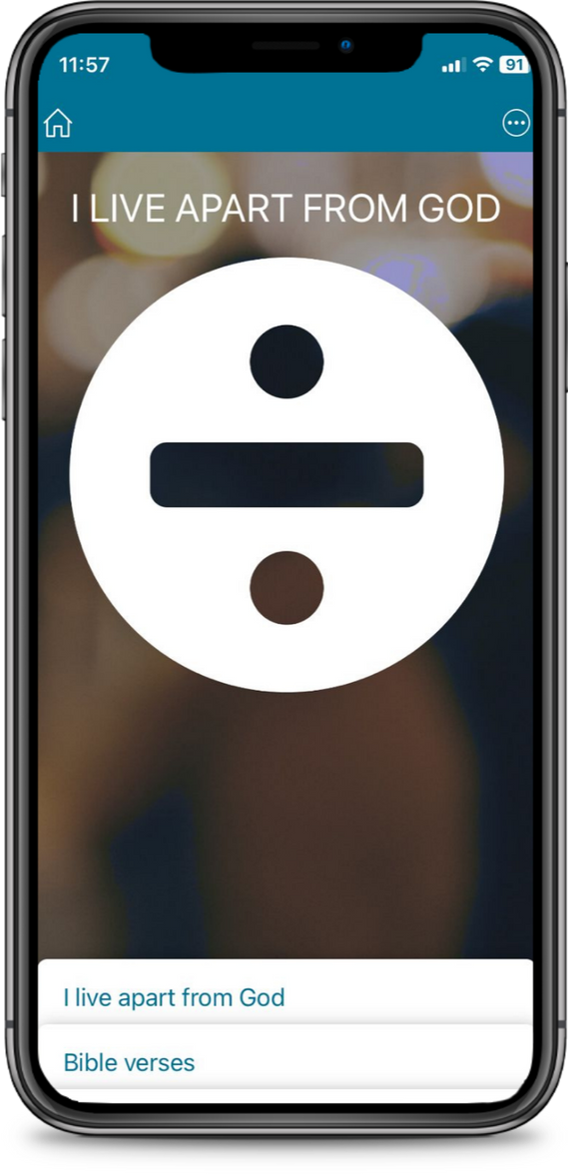
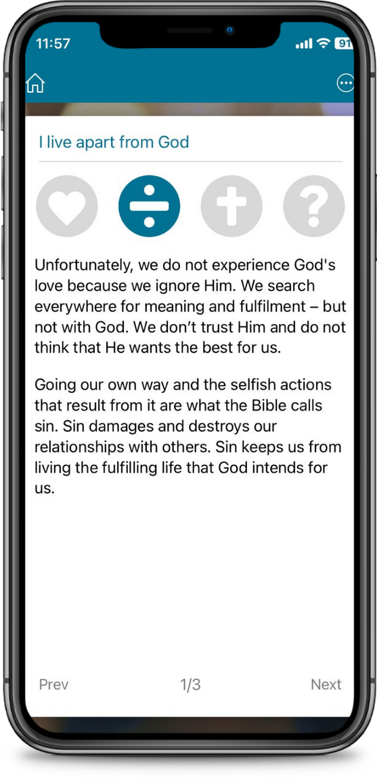
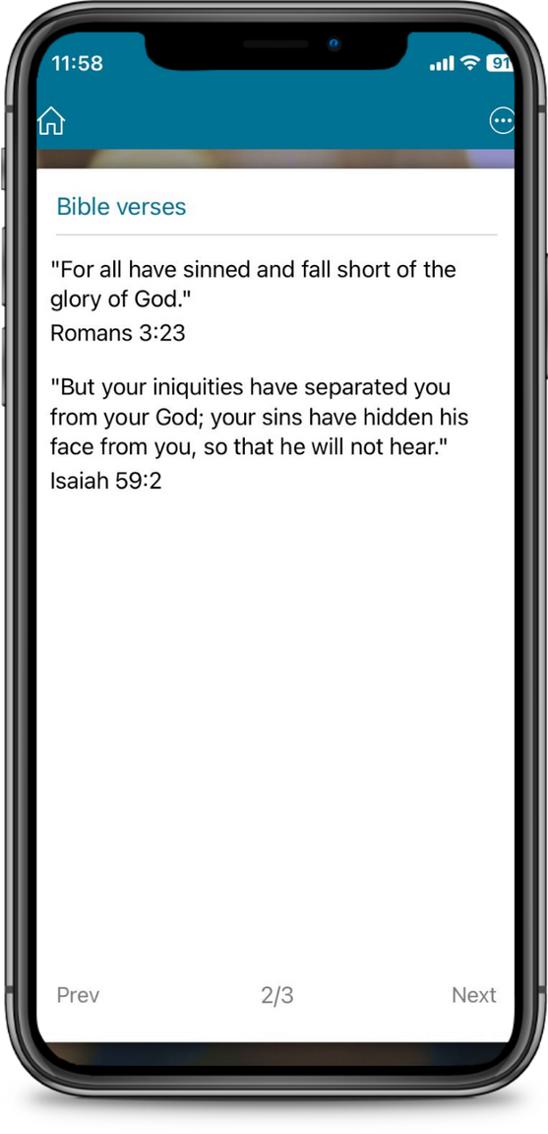

Slide 76
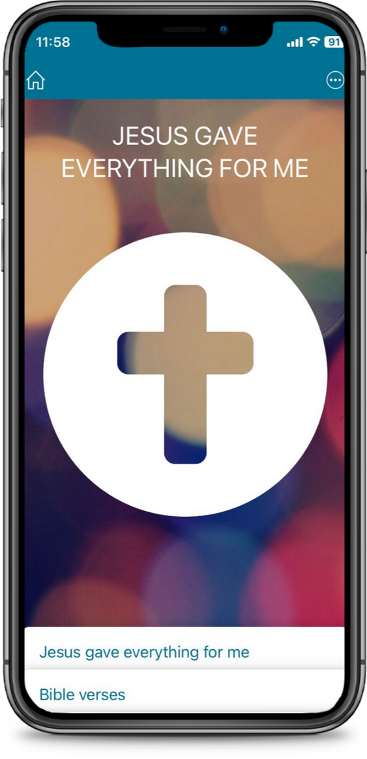
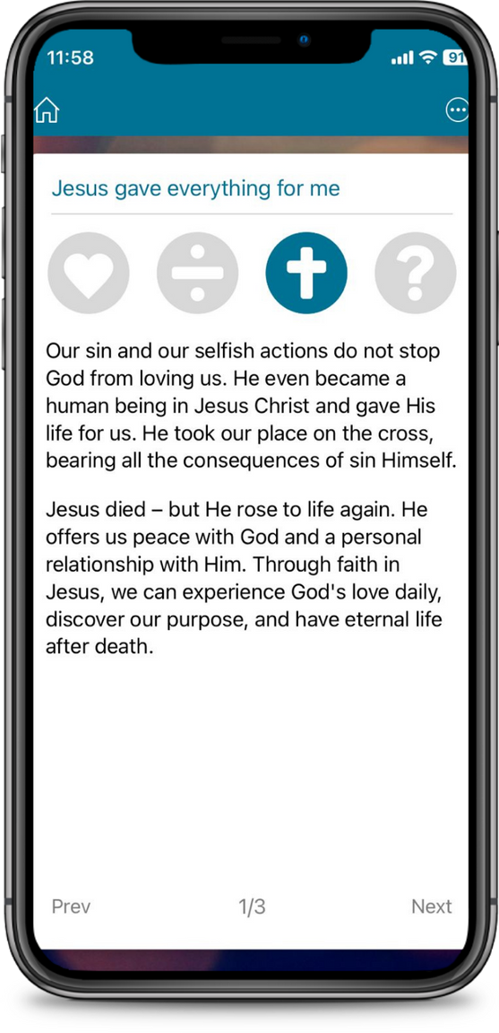
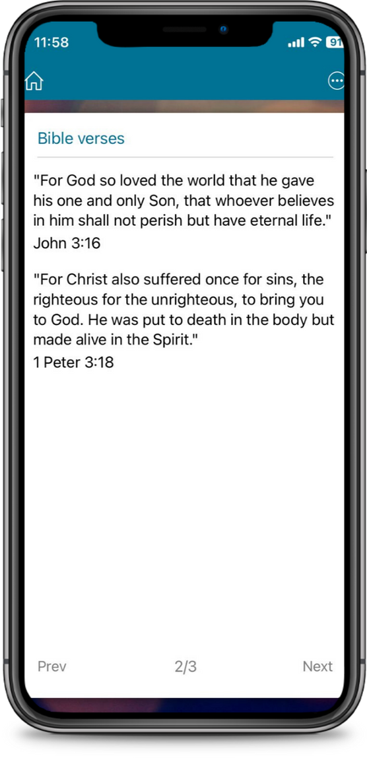

Slide 77
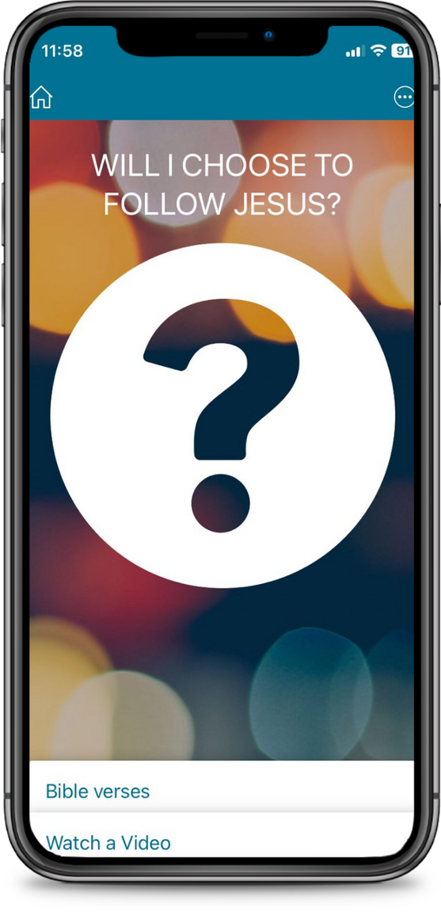
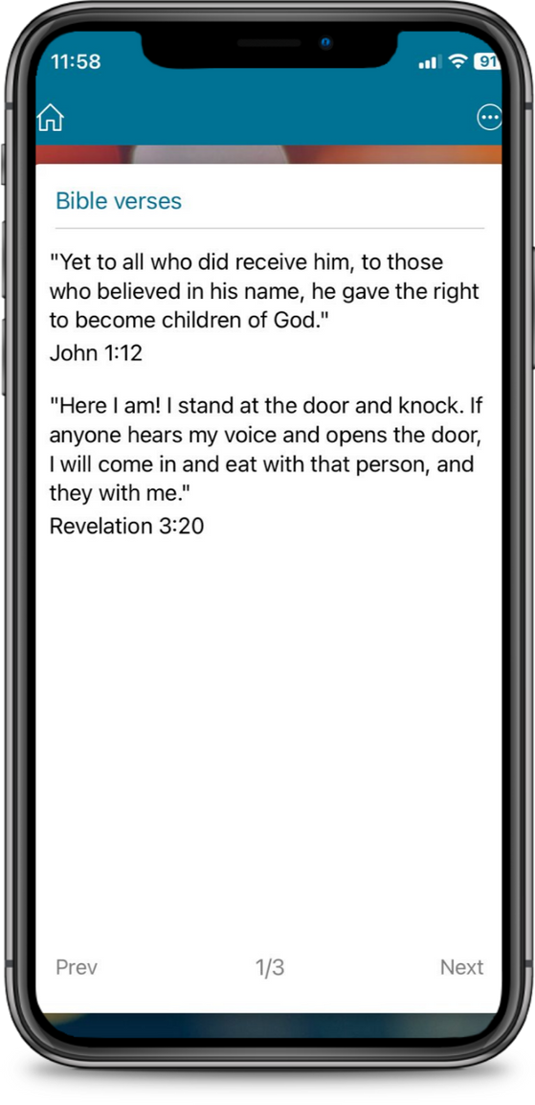
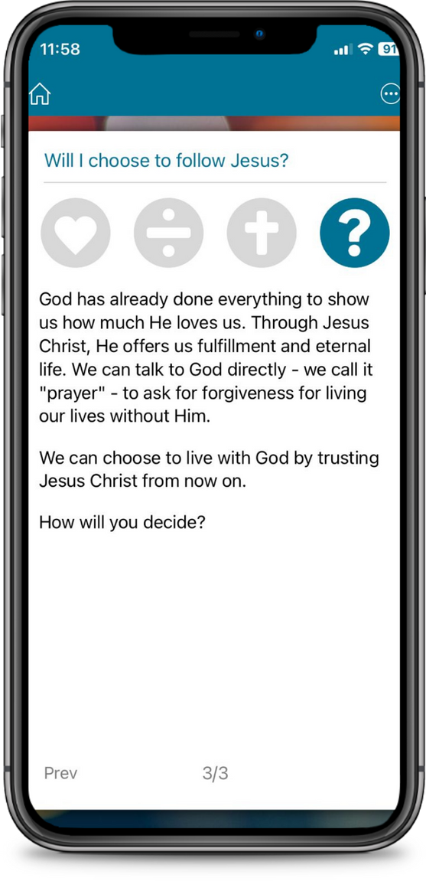

Slide 78
+MENTORSHIP
Pray
It helps to walk accompanied on the path in Grace, in Christ.
+M
Share
Care

Slide 79
IT IS VERY IMPORTANT TO WALK ALONG non-believers
until they grow
in their personal relationship
with Christ

Slide 80
FOUR CRUCIAL POINTS
Pray
MENTORSHIP
+M
+
+
Share
Relationships
of friendship
Accompaniment
Care
+
+
Inspiring Example
Bible-based
discipleship

Slide 81
FRIENDLY RELATIONSHIPS
Take scheduled times
Show appreciation with details
Exchange expectations
Pray
+M
Share
Care

Slide 82
Inspirational example
+Devotionals
+Enseñar a compartir
+Talk about challenges

Slide 83
Bible-based discipleship
Read
Study
Practice

Slide 84
VISIT OUR WEBSITE
www.evangelismoglobal.org

