Slide 1


Slide 2


Slide 3
Follow us on social media
https://www.facebook.com/GlobalOutreachDay
evangelismoglobal.gt@gmail.com
www.godecade.world

Slide 4

EVERYONE CAN
REACH OUT TO
SOMEONE.

Slide 5


Slide 6


Slide 7
DECADE OF EVANGELISM (GO DECADE) EXISTS TO HELP REACH THE WORLD TOGETHER.

Slide 8
IMAGINE WHAT COULD HAPPEN IN THE NEXT DECADE!

Slide 9

MAY 2023
WEEK 5
DISCIPLE
WEEK 4
PROCLAME
WEEK 3
SHARE
WEEK 2
ATTRACT
WEEK 1
PRAY AND GET READY
28 TO MAY 2023 AND ON
21 TO 27
MAY 2023
14 TO 20
MAY 2023
07 TO 13
MAY 2023
01 TO 06
MAY 2023

Slide 10
JOIN THOUSANDS OF CHURCHES
and ministries around the world
AND dedicate the entire month of May 2023
to sharing
the Gospel of Jesus Christ

Slide 11

IMAGINE HOW THIS
will impact your neighborhood,
your city, your country
and the world!

Slide 13

  Launch February 21
  90 Days of Hope (June - August)
  Witnessing Meetings
  December: GO Christmas Evangelism (GO Christmas)
  Decade of Evangelism Launch Meetings (1st, 2nd)
  Expand, complete the national Global Evangelism Team
  Continental Task Forces

Slide 14
THIS IS THE TIME!

Slide 15

Evangelism
TOOL
Dr. Milton Gay

Slide 16

LEMA
Train and involve the local church.
VISION
To advance the kingdom of God by preserving and propagating the gospel of Holiness.
MISION
Reach out to our communities proclaiming the message of salvation.
Evangelism
TOOL

Slide 17


ALPHA
A digital evangelistic tool, relational, dynamic, innovative, highly multiplicative and free.
It is easy to implement both online and in person.
Evangelism
TOOL

Slide 18



Slide 19
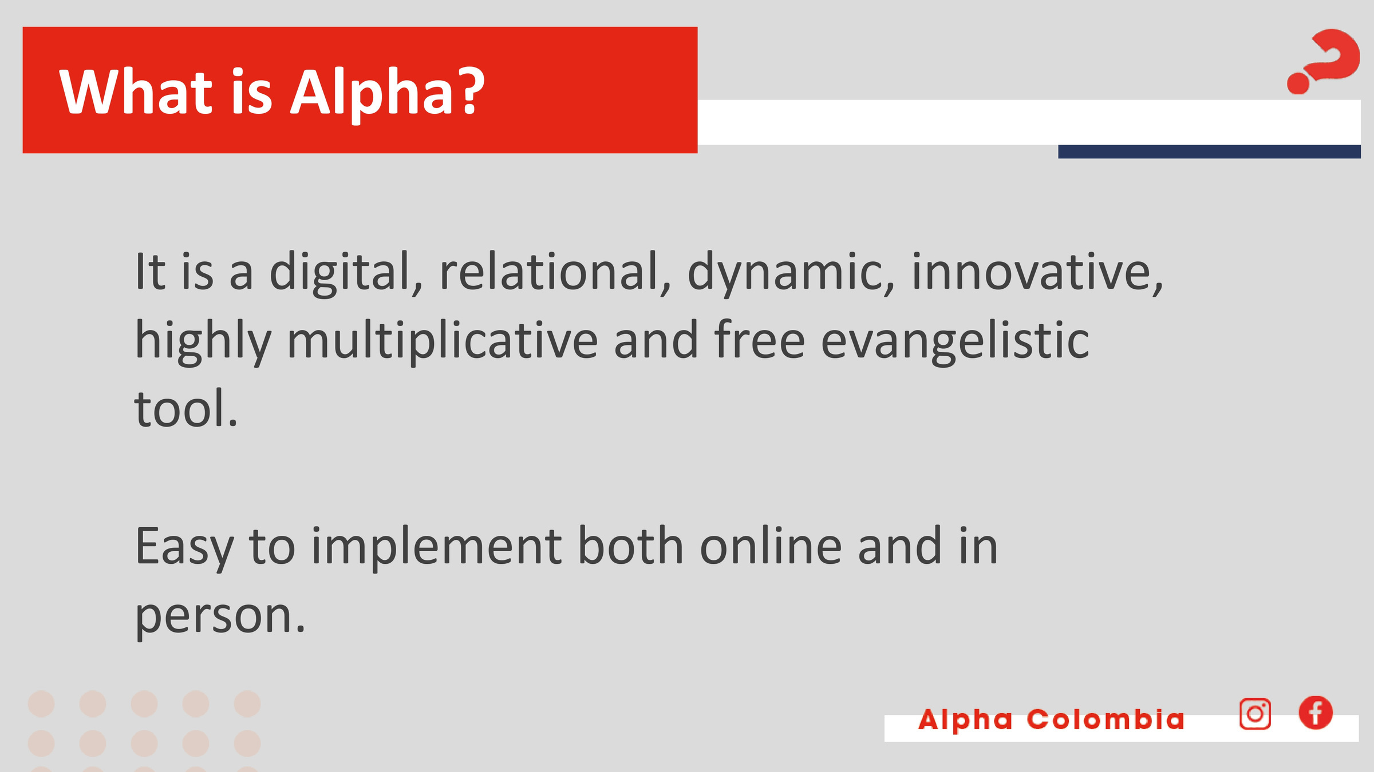

Slide 20


Slide 21
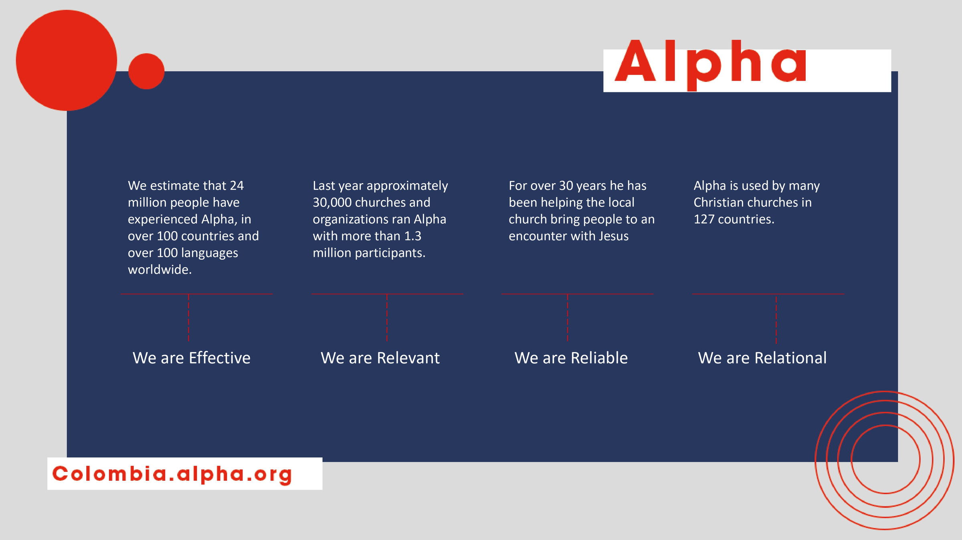

Slide 22


WITH
ALPHA
WE CAN ALL DO OUR PART IN BRINGING ANOTHER TO JESUS

Slide 23




What are the Alpha sessions like?
Alpha sessions are held once a week for 1 hour and 30 minutes.
The following three elements are present in each session
food
Video
discussion
Small group conversation
+ FUN

Slide 24
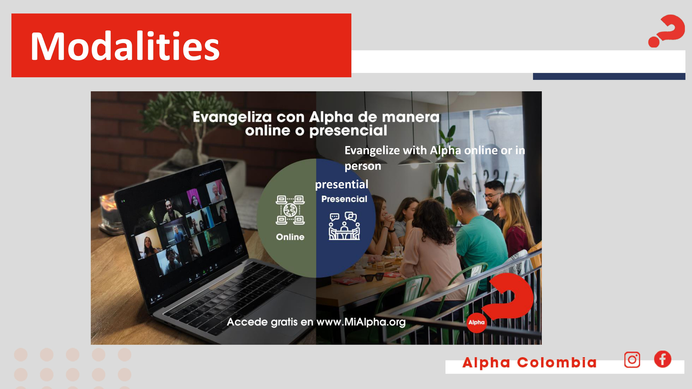

Slide 25

No two Alpha's are alike, but they all have these elements in common

Slide 26

FOOD
At the beginning of the session, it is a time to get to know each other better in the group.

Slide 27

ALPHA FOR TEENS
GAMES GUIDE
ALPHA FOR TEENS
GAMES GUIDE
ALPHA FOR TEENS
GAMES GUIDE
INDOOR
OUTDOOR
VIRTUAL
Available for download
FUN
Alpha with teenagers and young adults / can't miss

Slide 28

TALK
Videos of the series with 3 conversation breaks

Slide 29
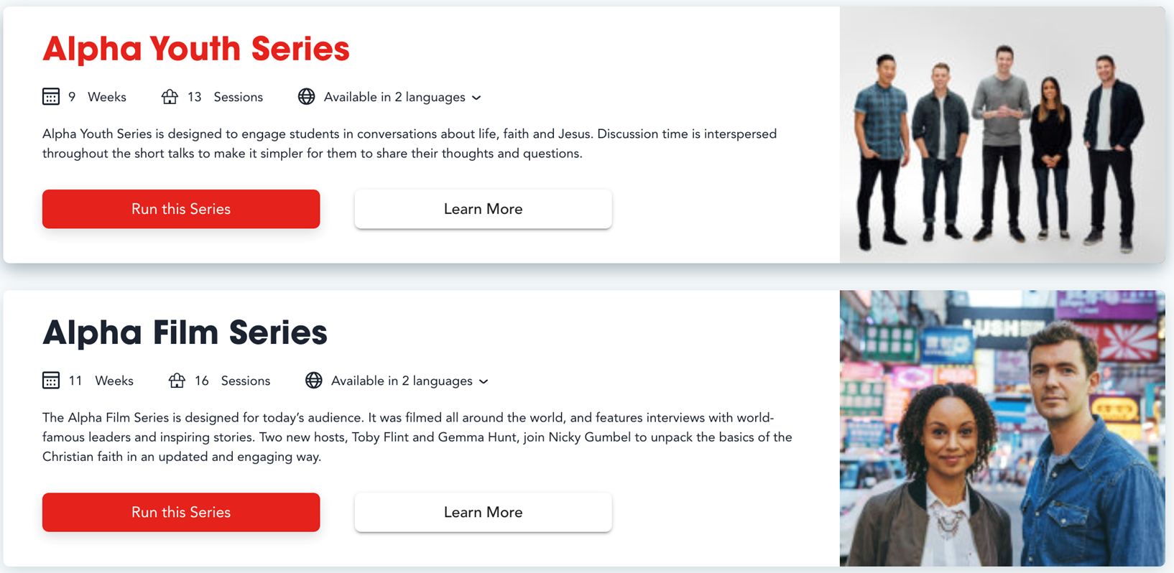

RESOURCES

Slide 30

OTHER RESOURCES

Slide 31
Prayer in Alpha
During the first 4 sessions we do not pray WITH the guests, but the hosts do pray FOR the guests.
We go from- to + / start praying in session 5.
In a simple and easy way, without using very religious language.
It has a special methodology / 3 moments for the Alpha day and on the theme: Healing.
In the learning center you will find videos to expand this information.

Slide 32
ALPHA
DAY
The themes dedicated to the Holy Spirit are developed on a special day, in a different place than where we regularly meet, it can be on a weekend or Alpha Day that combines recreation, teaching, conversation and prayer.
On the page you will find a training video on Alpha Day.

Slide 33
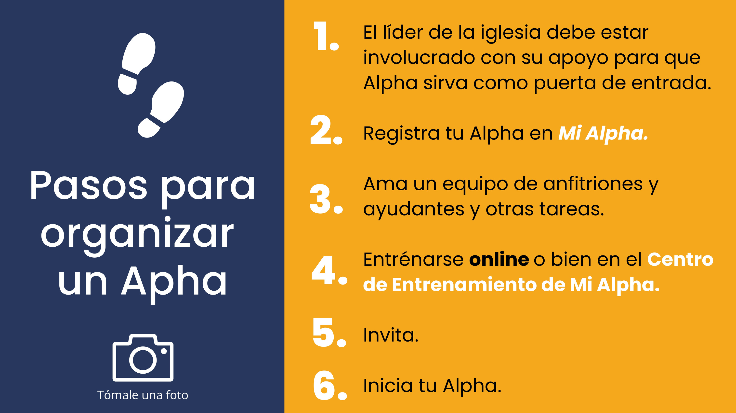
The church leader must be involved with your support for Alpha to serve as a gateway.
Register your Alpha in My Alpha
Steps to organize Alpha
Assemble a team of hosts and helpers and other tasks.
Get trained online or in the My Alpha Training Center
Invite
Start your Alpha
Take a photo

Slide 34
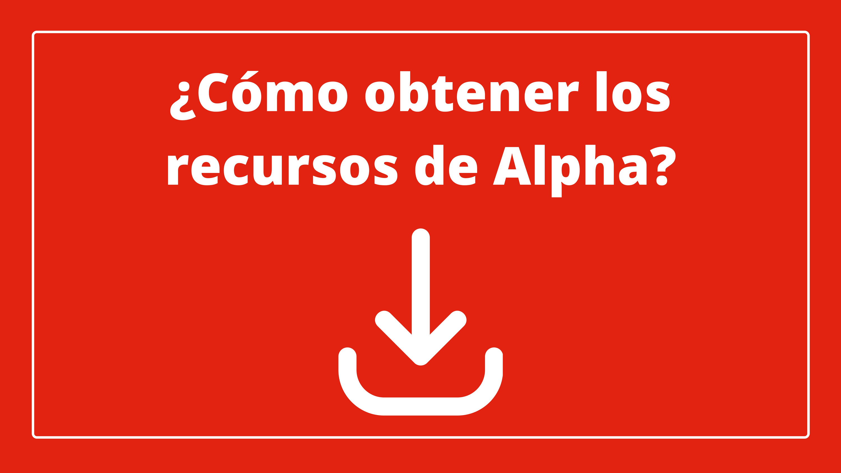
How to obtain Alpha's resources?

Slide 35

LOG IN TO

Slide 36
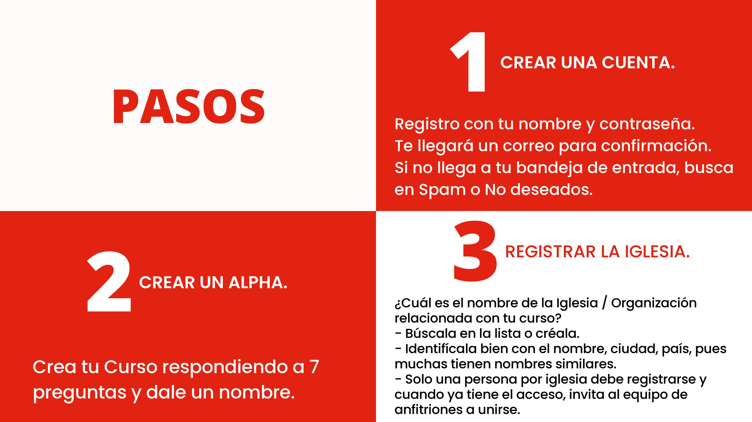
STEPS
CREATE AN ACCOUNT
  Register with your name and passwor.
  You will receive a confirmation email.
  Check your inbox for spam or junk mail.
REGISTER THE CHURCH
CREATE AN ACCOUNT
What is the name of the church/organization related to the course?
  Look it up in the list or create it.
  dentify it well with name, city, country, as many have similar names.
  Only one person per church should register and once you have access, invite the host team to join.
  Create a course by answering 7 questions and give it a name.

Slide 37


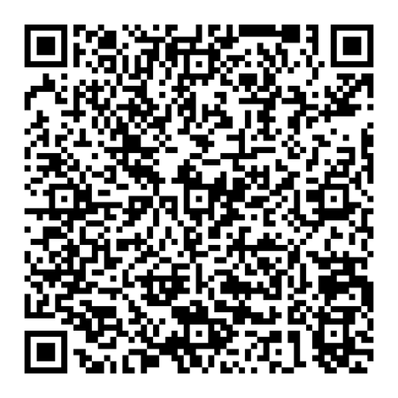
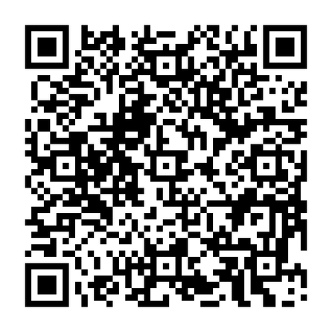


JESUS FILM
Evangelism
TOOL

Slide 38


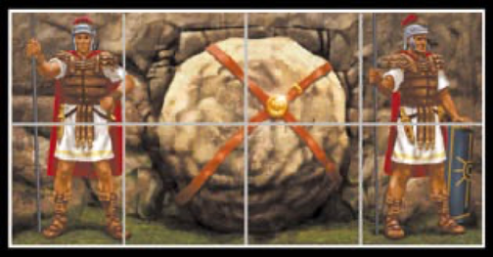
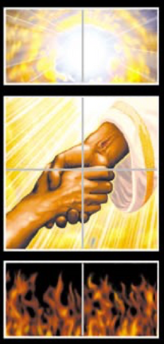

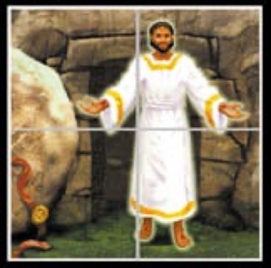
EVANGELISTIC CUBE
Evangelism
TOOL
GOD LOVES YOU +
You are a sinner
  JESUS DIED FOR YOUR SINS
  HE WAS BURIED
  GOD RAISED JESUS FROM THE DEAD
  JESUS IS THE ONLY WAY TO GOD
  BELIEVE IN HIM AS YOUR SAVIOR

Slide 39

EVANGELISTIC BALL
BLACK
Sin and separation with God
RED
God's love shown in Jesus' cross
WHITE
God's forgiveness cleansing for us
GREEN
The Growth of the children of God through spiritual disciplines
YELLOW
The promise of eternal life with God in heaven

Slide 40

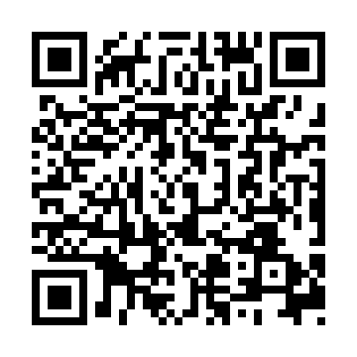
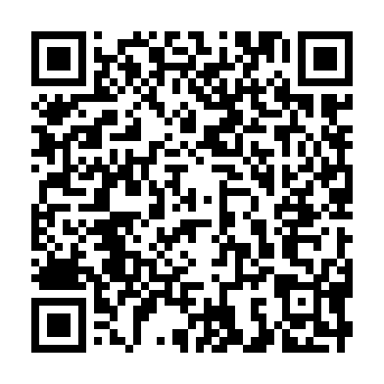

Slide 41




THE FOUR
CONNECTION WITH THE LOST (JOHN 4: 7-15)

Slide 42
THESE FOUR SYMBOLS REPRESENT THE CENTRAL MESSAGE OF THE BIBLE
God loves you
totally!
His love is unlimited
and unconditional.
Genesis 1:31
Doing things our own way is what the Bible calls sin
Romans 3:23
Our sin does not prevent God from loving us!
On the cross, Jesus took the punishment for our sins
John 3:16
DECISION
He offers us a full and eternal life through Jesus Christ. Each person is challenged to make a decision.
John 1:12

Slide 43
THESE FOUR SYMBOLS REPRESENT THE CENTRAL MESSAGE OF THE BIBLE
God loves you
totally!
His love is unlimited
and unconditional.
Genesis 1:31
Our sin does not prevent God from loving us!
On the cross, Jesus took the punishment for our sins
John 3:16
DECISION
He offers us a full and eternal life through Jesus Christ. Each person is challenged to make a decision.
John 1:12
Doing things our own way is what the Bible calls sin
Romans 3:23

Slide 44
THESE FOUR SYMBOLS REPRESENT THE CENTRAL MESSAGE OF THE BIBLE
Doing things our own way is what the Bible calls sin
Romans 3:23
God loves you
totally!
His love is unlimited
and unconditional.
Genesis 1:31
Our sin does not prevent God from loving us!
On the cross, Jesus took the punishment for our sins
John 3:16
DECISION
He offers us a full and eternal life through Jesus Christ. Each person is challenged to make a decision.
John 1:12

Slide 45
THESE FOUR SYMBOLS REPRESENT THE CENTRAL MESSAGE OF THE BIBLE
Our sin does not prevent God from loving us!
On the cross, Jesus took the punishment for our sins
John 3:16
God loves you
totally!
His love is unlimited
and unconditional.
Genesis 1:31
Doing things our own way is what the Bible calls sin
Romans 3:23
DECISION
He offers us a full and eternal life through Jesus Christ. Each person is challenged to make a decision.
John 1:12

Slide 46
THESE FOUR SYMBOLS REPRESENT THE CENTRAL MESSAGE OF THE BIBLE
DECISION
He offers us a full and eternal life through Jesus Christ. Each person is challenged to make a decision.
John 1:12
God loves you
totally!
His love is unlimited
and unconditional.
Genesis 1:31
Doing things our own way is what the Bible calls sin
Romans 3:23
Our sin does not prevent God from loving us!
On the cross, Jesus took the punishment for our sins
John 3:16

Slide 47


GOD
MAN
CHRIST
THE GOSPEL
with the hands
FAITH
GRACE

Slide 48
THE GOSPEL
with the hands
S
ETERNAL LIFE IS A GIFT AND THEREFORE CANNOT BE EARNED OR DESERVED.
Romans 6:23
Ephesians 2:8-9
GRACE

Slide 49
MAN
MANKIND IS SINFUL. IT CANNOT SAVE ITSELF.
Romans 3:23
Matthew 5:48
THE GOSPEL
with the hands

Slide 50
GOD
GOD IS MERCIFUL, BUT HE IS ALSO JUST.
1 John 4:8
Exodus 34:7b
THE GOSPEL
with the hands

Slide 51
CHRIST
THE GOSPEL
with the hands
HE DIED ON THE CROSS, ROSE FROM THE DEAD TO PAY FOR OUR SINS.
JOHN 1:1 AND 14
ISAIAH 53:6

Slide 52
SAVING FAITH IS NOT MERE INTELLECTUAL KNOWLEDGE, NOR IS IT TEMPORAL FAITH. SAVING FAITH IS BY TRUSTING IN JESUS CHRIST ALONE FOR ETERNAL LIFE.
James 2:19
Acts 16:31
THE GOSPEL
with the hands
FAITH

Slide 53





THREE THIRDS
A Discipleship Formation Process

Slide 54





OVERVIEW
LOOKING BACK
LOOKING UP
LOOKING FORWARD
  Careful "How are you?”
  Worship
  Celebrating Loyalty - Accountability & Review
  Fostering Vision & Encouragement - Vision
  New Lesson Obedience-Based Bible Study (Biblical Content that leads to obedience)
  Preparing for the Mission. Practice. Confidence to obey and train others.
  Mission Achievement Applications Goal setting
  Praying for Mission

Slide 55
LOOKING BACK
  Care "How are you?"- worship- Celebrating Fidelity - Accountability & Review - Encouraging Vision & Encouragement - Vision
ORIGINAL
RED PARTS ARE IMPORTANT FOR MULTIPLICATION.
  Asking questions "How are you? How was your week'?" Celebrating Loyalty - How did you achieve your commitments last week? - Encourage Vision & Encouragement - Vision Remind them of our goals and if one didn't make it encourage them to keep going and not give up.
EXAMPLE
GREEN PARTS ARE IMPORTANT FOR GROWTH AND HEALTH.
  It will help the person think and reflect. "How do you feel?" Celebrating Fidelity - Tell me how you made it? - Encouraging Vision & Encouragement - What is the most rewarding thing you did?
ACCOMPANIMENT

Slide 56
LOOKING UP
  New Lesson. Obedience Based Bible Study (Biblical content that leads to obedience).
ORIGINAL
GREEN PARTS ARE IMPORTANT FOR GROWTH AND HEALTH.
  Mention what will be discussed today, based on obedience and biblical content."
EXAMPLE
  Help the person think and reflect on the content given that day.
ACCOMPANIMENT

Slide 57
LOOKING FORWARD
  Preparing for the Mission. Practice. Confidence to obey and train others - Applications to Achieve the Mission. Setting goals - Praying for the Mission
ORIGINAL
RED PARTS ARE IMPORTANT FOR MULTIPLICATION.
  Ask what you will do in practice. According to the lessons; what will your goals be; what will you do; what will you implement from what you learned today?
EXAMPLE
GREEN PARTS ARE IMPORTANT FOR GROWTH AND HEALTH.
  Help the person reflect on the future. Questions such as: How will you do it, what will you do, when will you do it, what is the next step you will take?
ACCOMPANIMENT

Slide 58





Strategy
PCS+M
Pray
+M
Share
Care

Slide 59
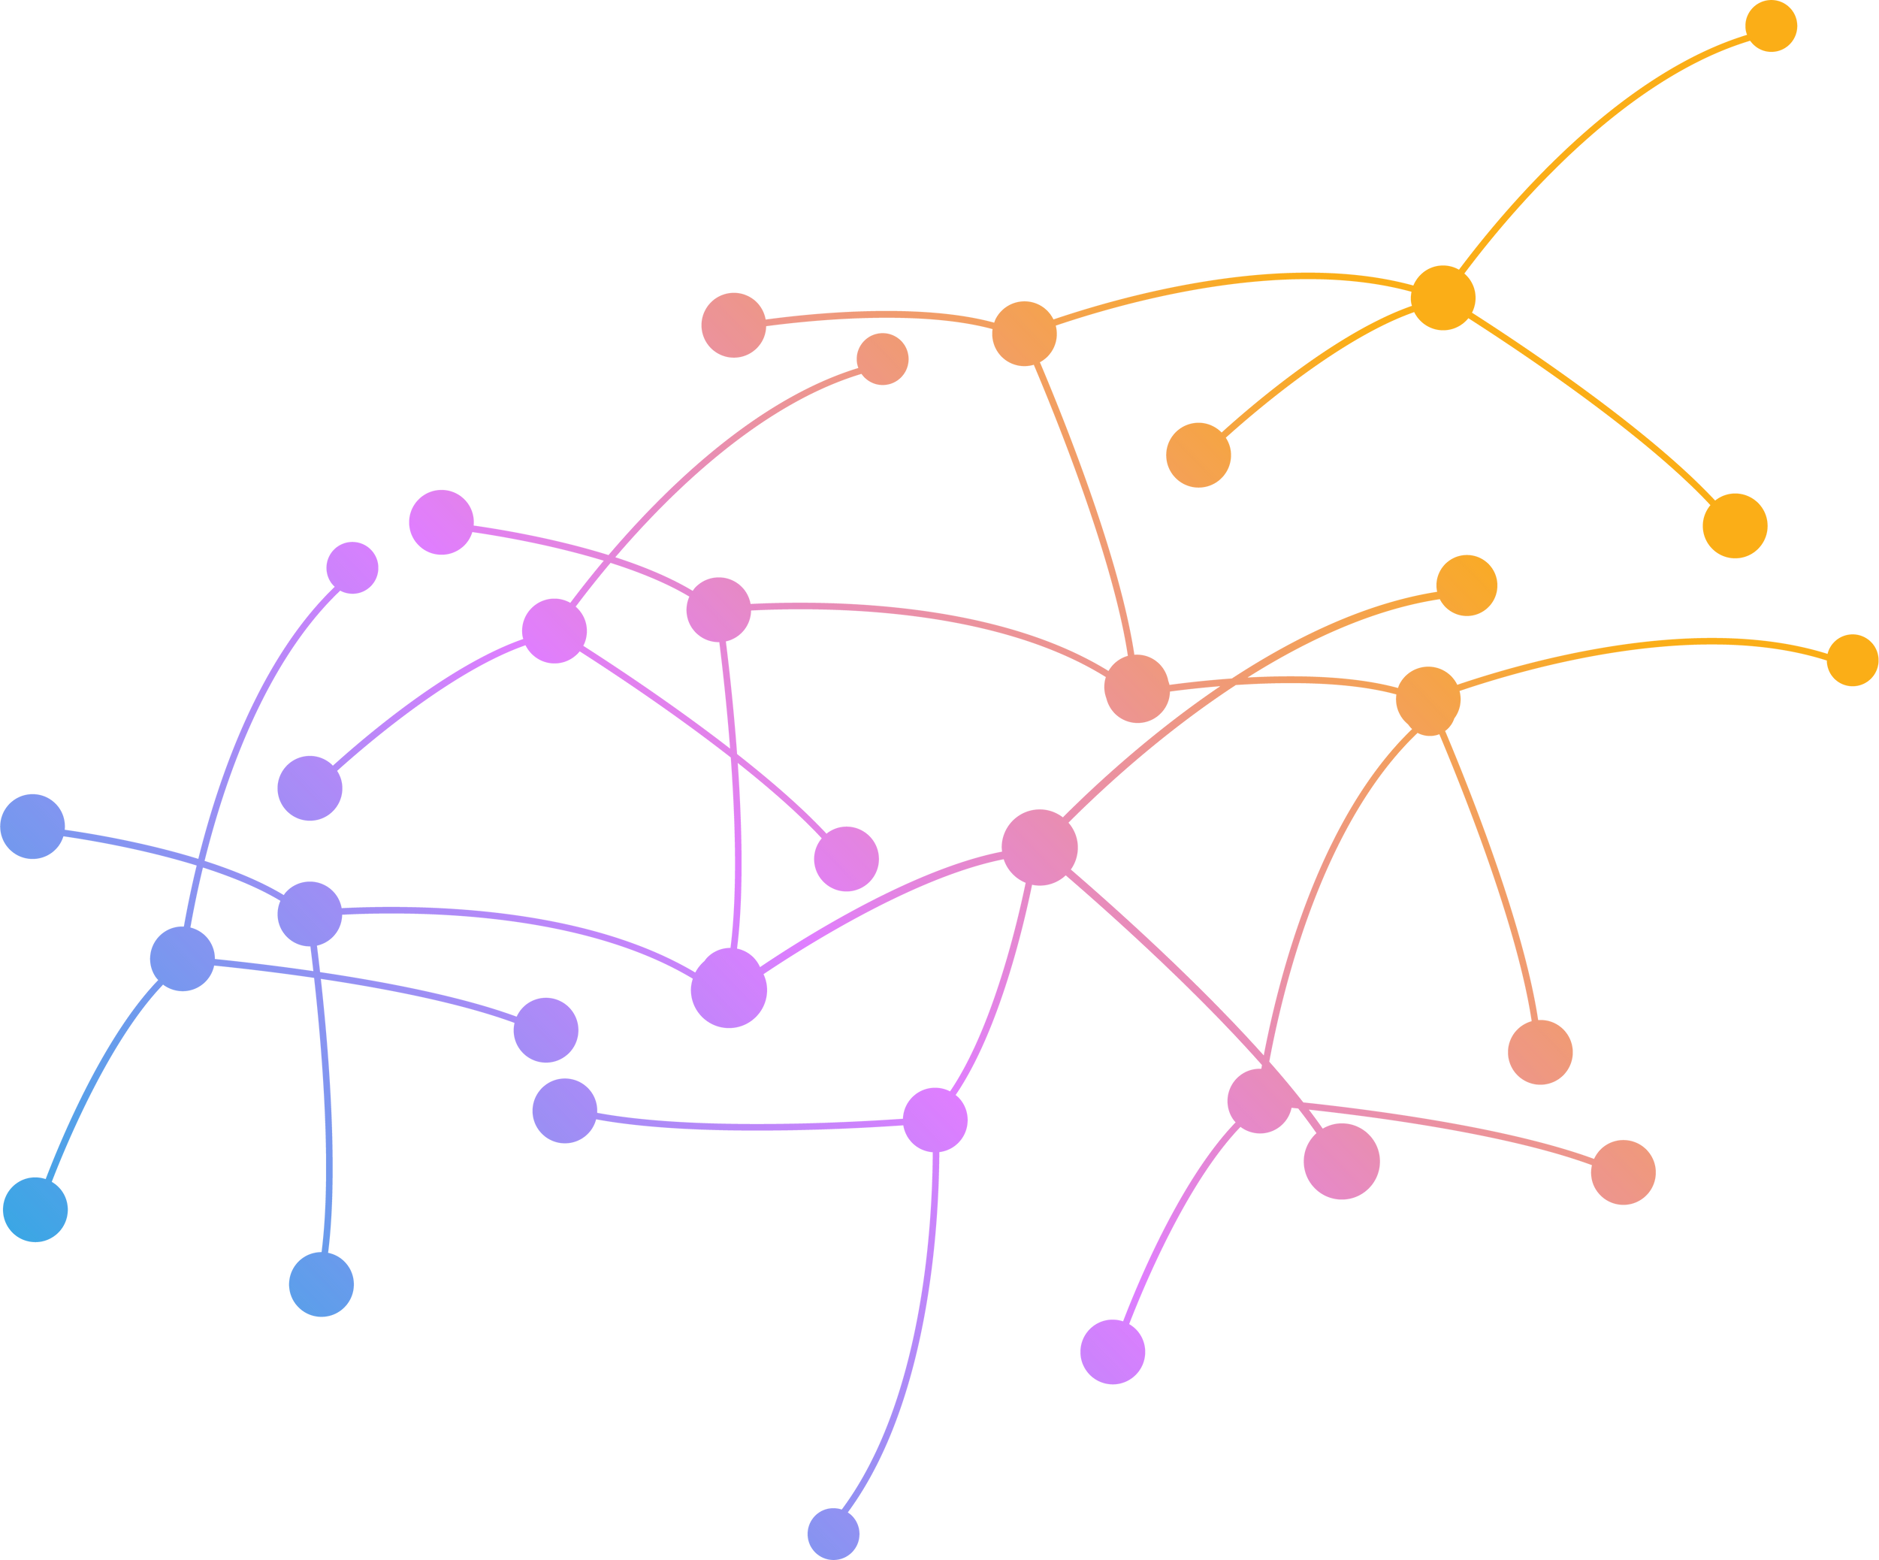
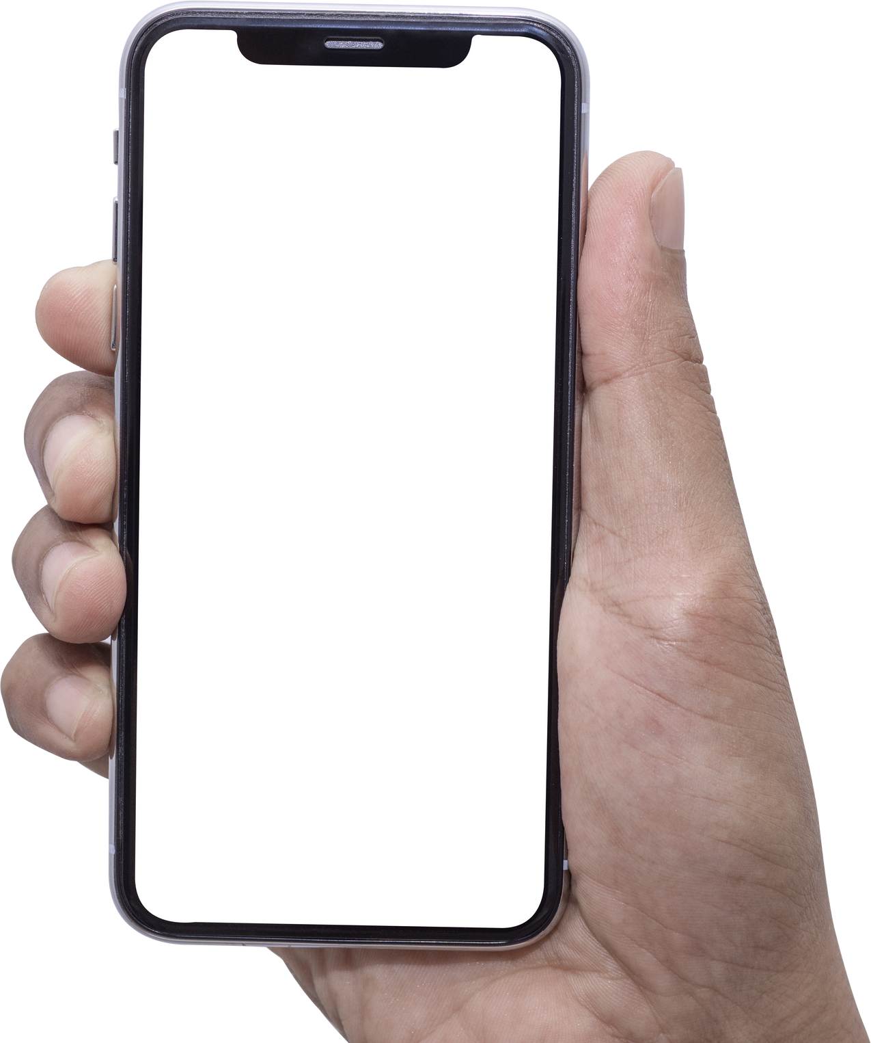






NETWORK
relational
Neighbors
Family
Work
University
School
Sport

Slide 60


PRAY
"Tell God about people before you tell people about God." - Bill Bright
Prepare our hearts to share the Gospel and also the heart of the unbeliever to receive it. Salvation is God's work in the heart of man.
Pray
+M
Share
Care

Slide 61
PRAY
Pray
  Make a list
  The amazing question
+M
Share
Care

Slide 62
PRAY
Together with the community you can PRAY
Pray
+M
Share
virtually go to their jobs to their homes, using the Google Earth application.
Care

Slide 63
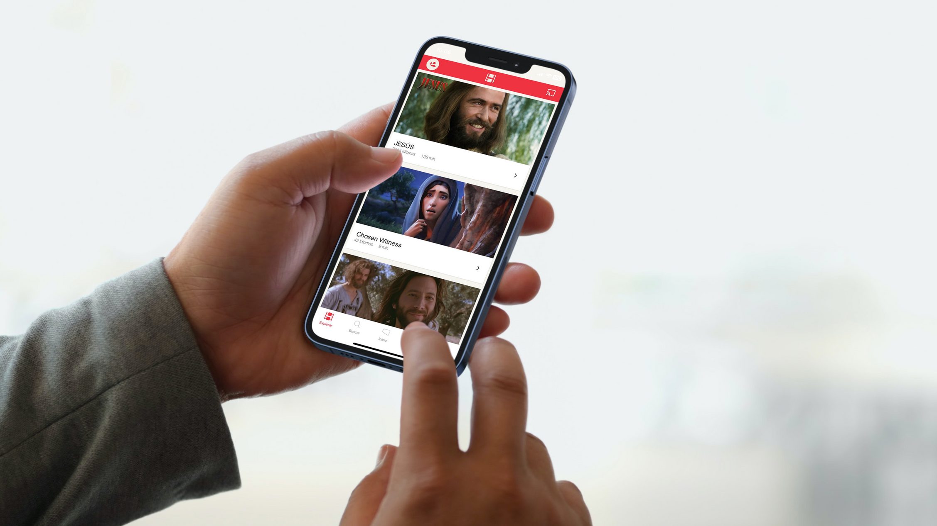
ALL
everywhere

Slide 64
JESUS FILM

Slide 65
CARE
Pray
+M
Share
Care
  Serve people with acts of kindness and things they cannot do for themselves.
  They may believe in God because of the fruit of showing them the love God has put in your heart for them.

Slide 66

Pray
PERSONAL TESTIMONY - GODTOOLS
+M
Share
Care
THE FOUR
SHARE

Slide 67
WRITE DOWN
the changes

Slide 68
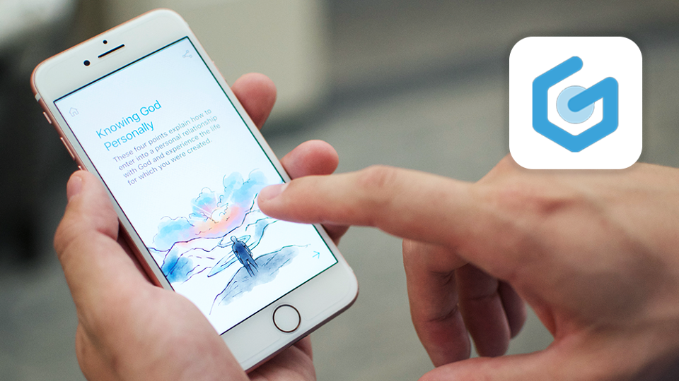

Slide 70
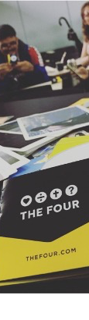

THE FOUR
CONNECTION WITH THE LOST (JOHN 4: 7-15)

Slide 71
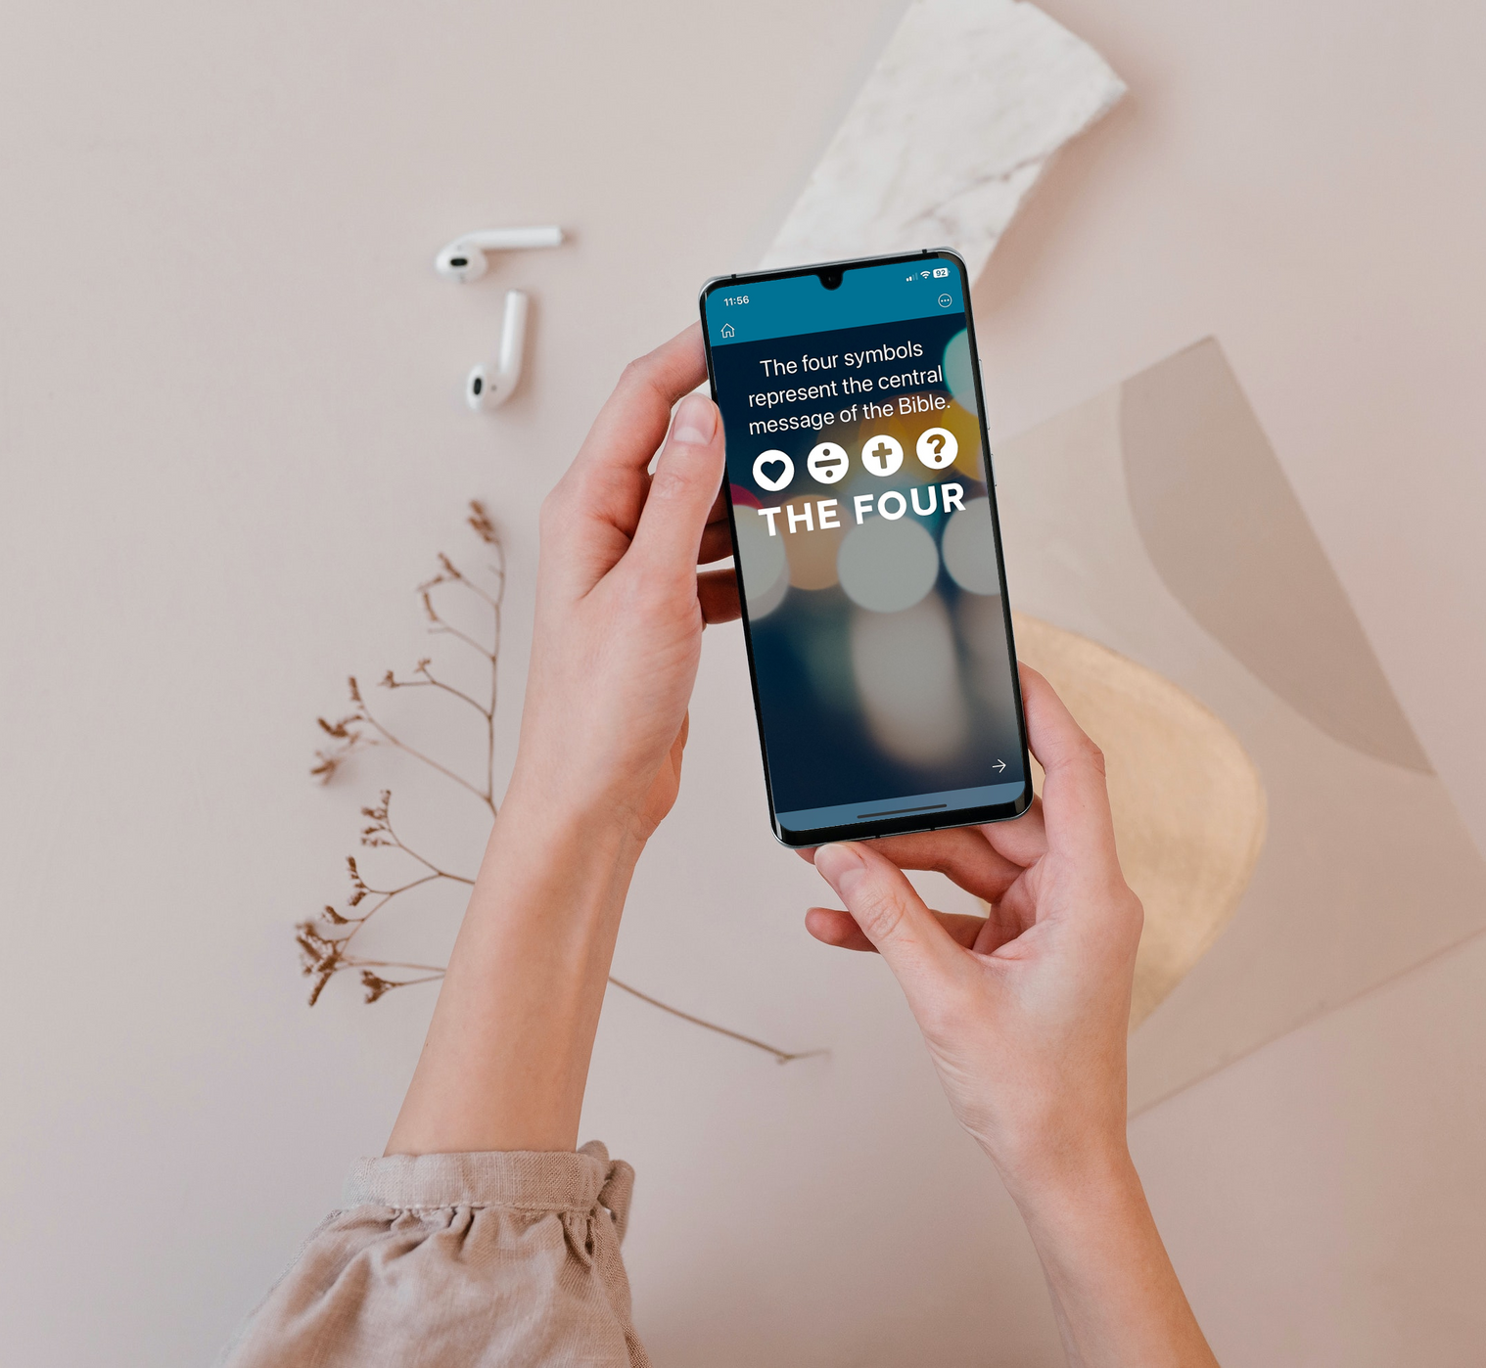

YOU ASK YOURSELF, HOW COULD YOU SHARE THE CHRISTIAN FAITH in a clear and simple way?

Slide 72
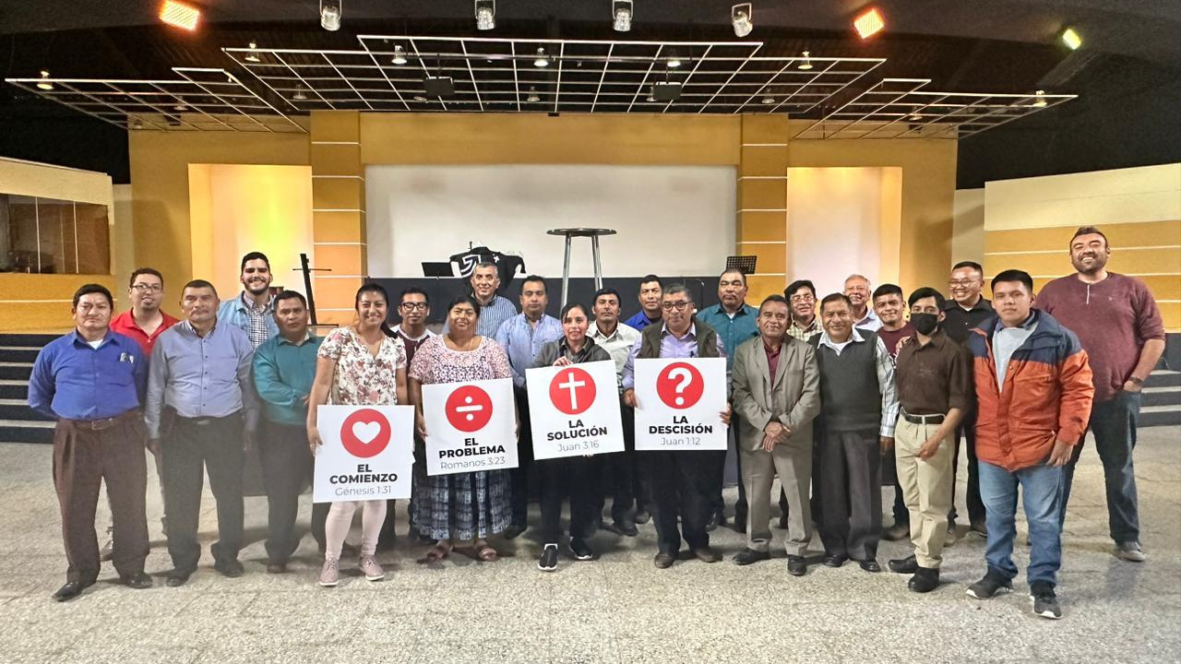
THESE FOUR SYMBOLS REPRESENT THE CENTRAL MESSAGE OF THE BIBLE

Slide 73
ADVANTAGES
Graphical simplicity / Innovative
Easy to use / Brings clarity to the message

Slide 74
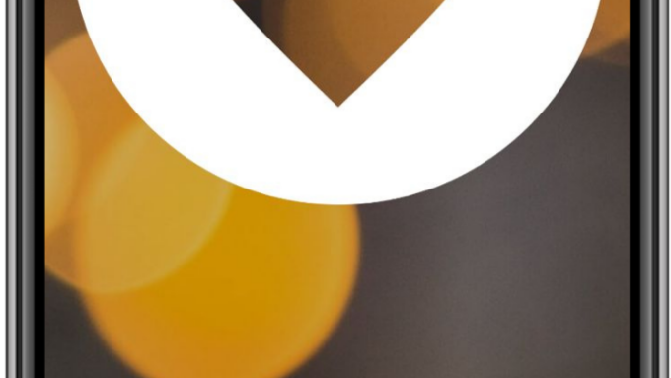
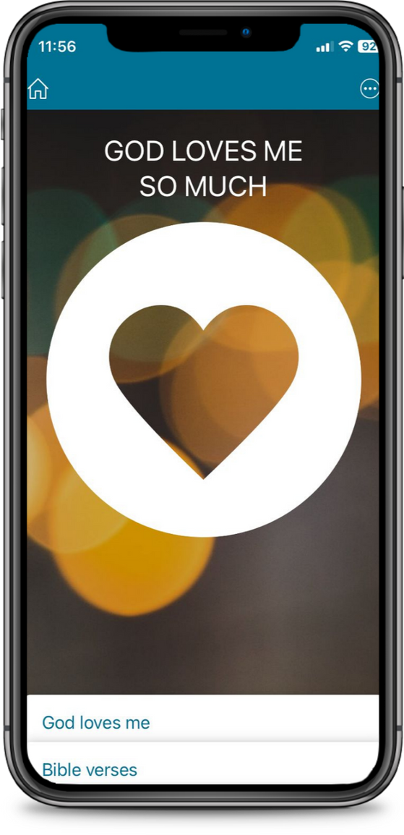
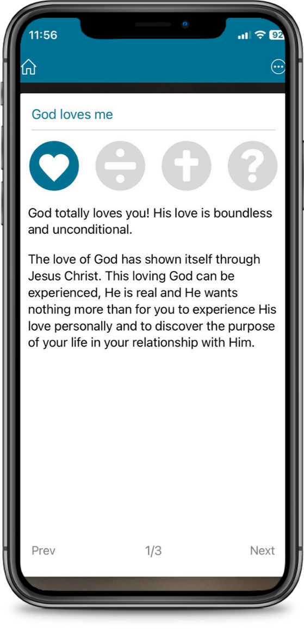
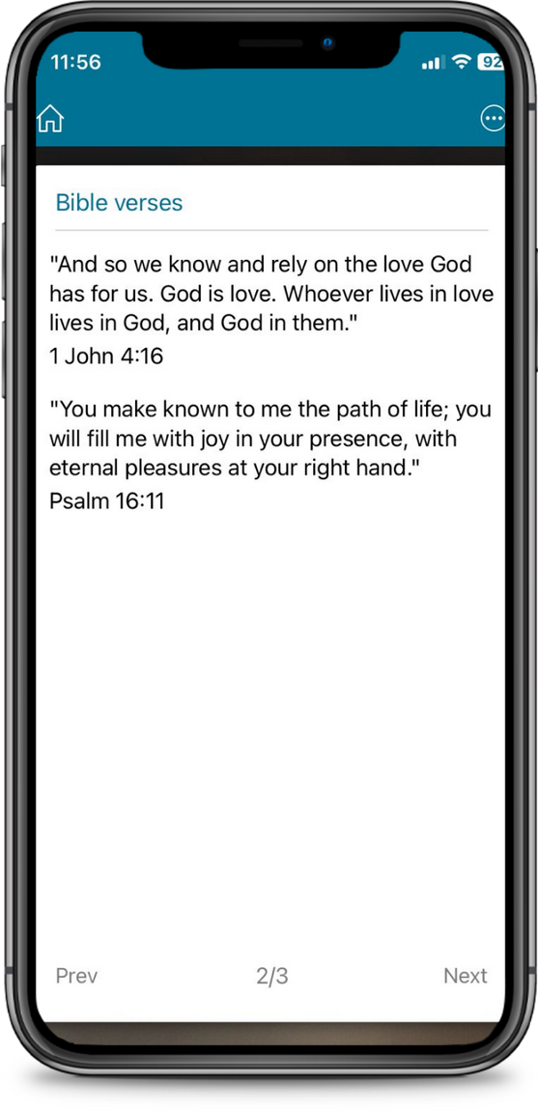

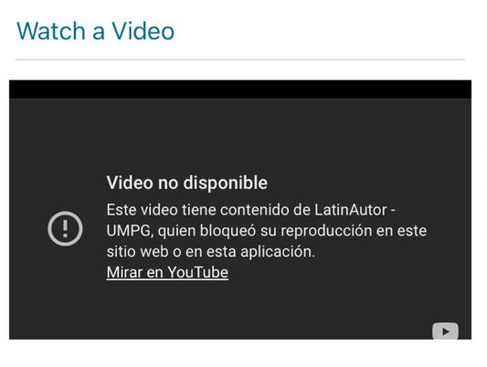
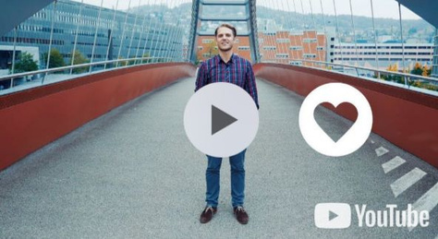

Slide 75
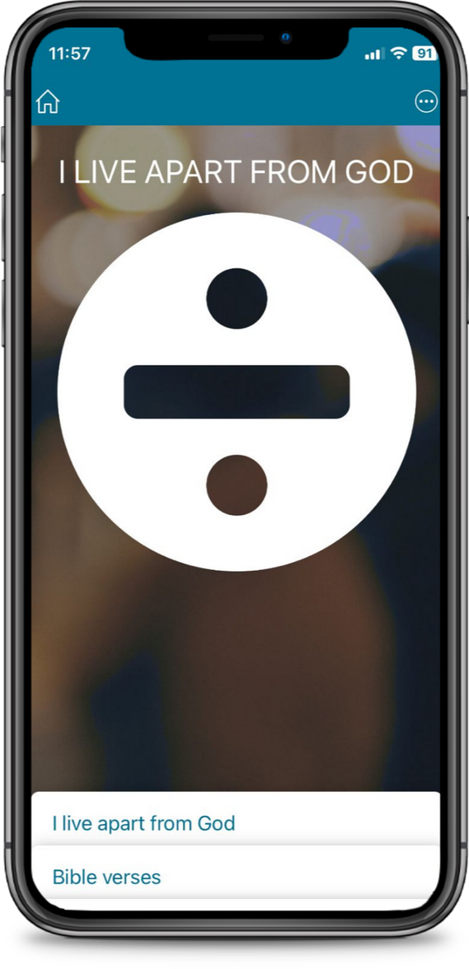
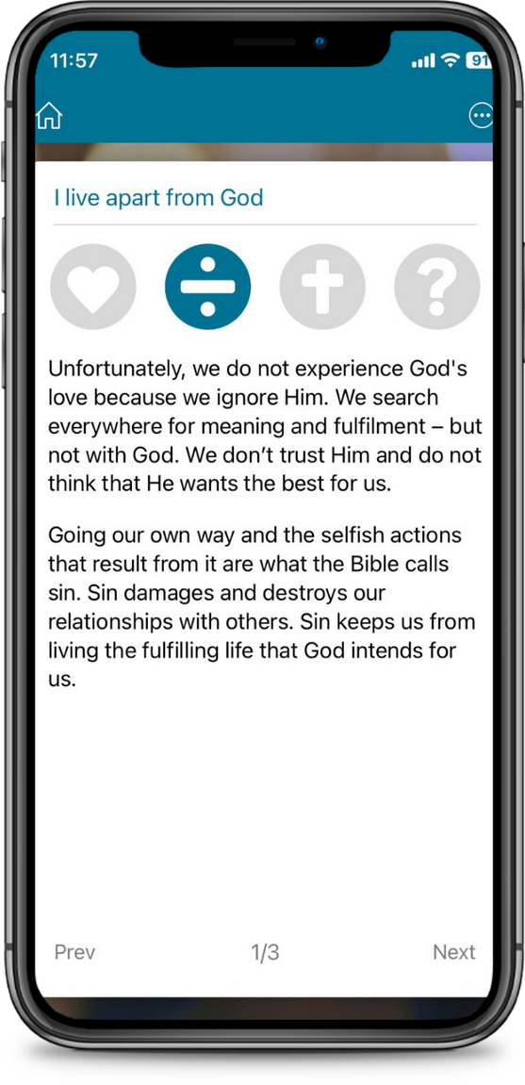
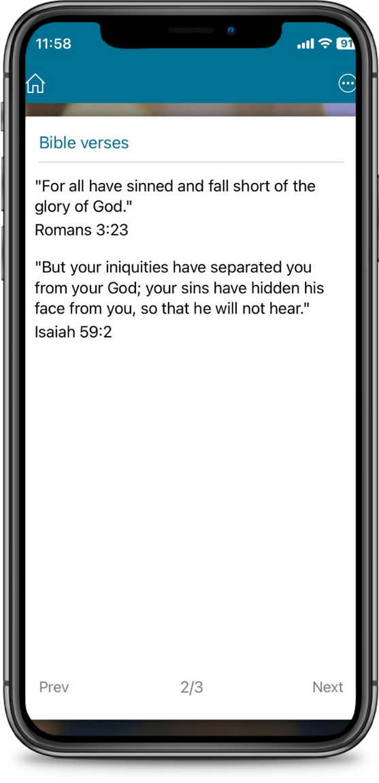
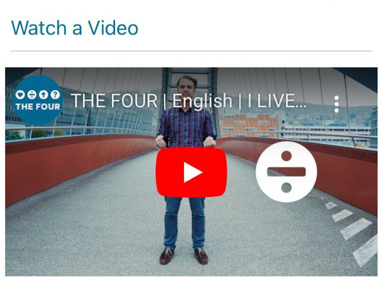

Slide 76
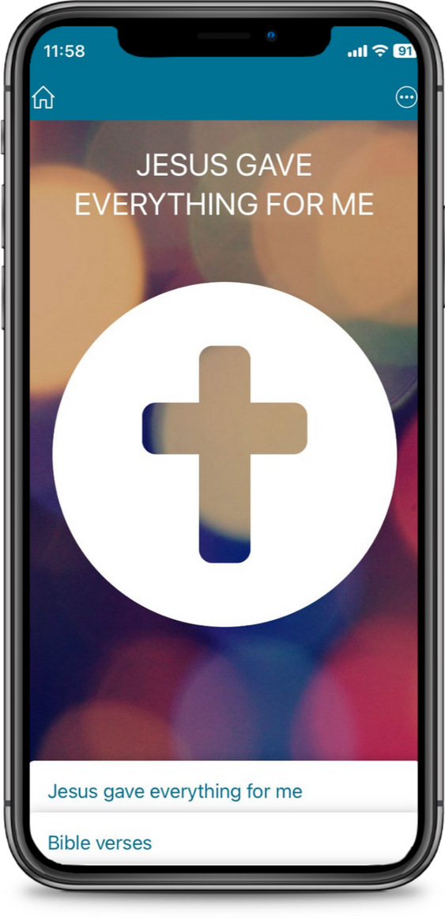
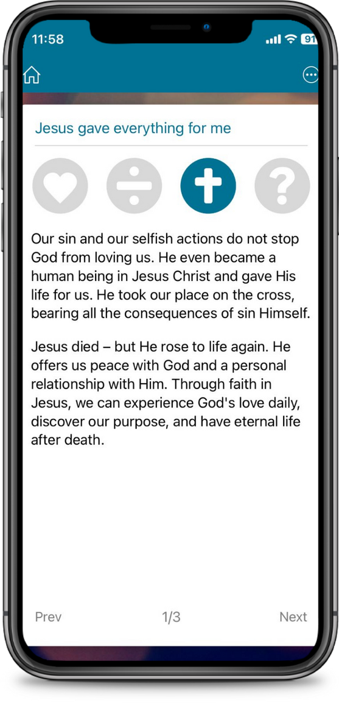
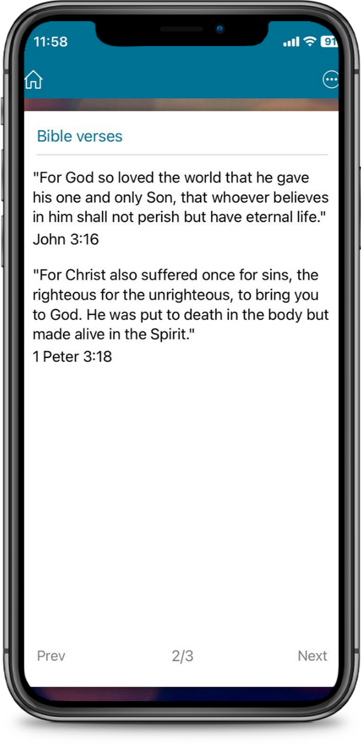
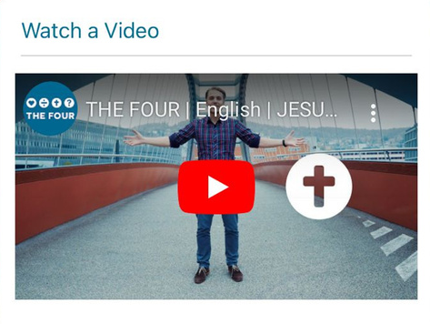

Slide 77
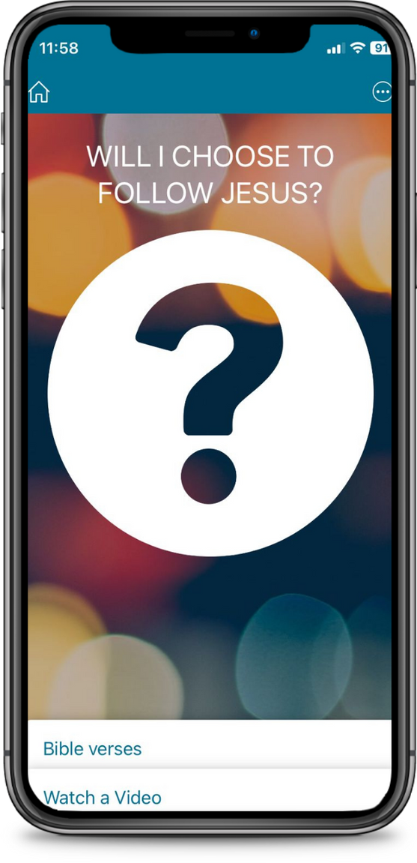
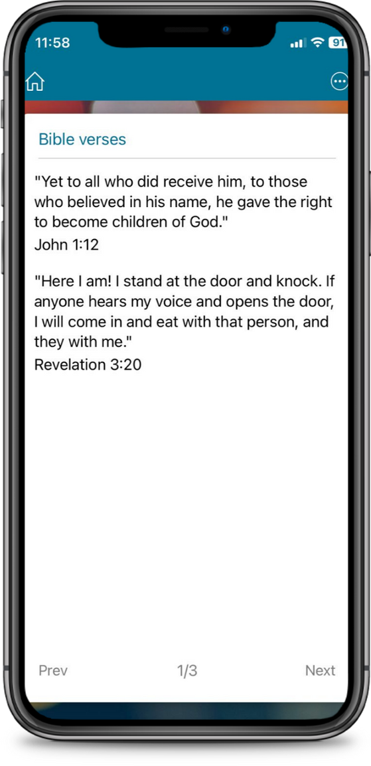
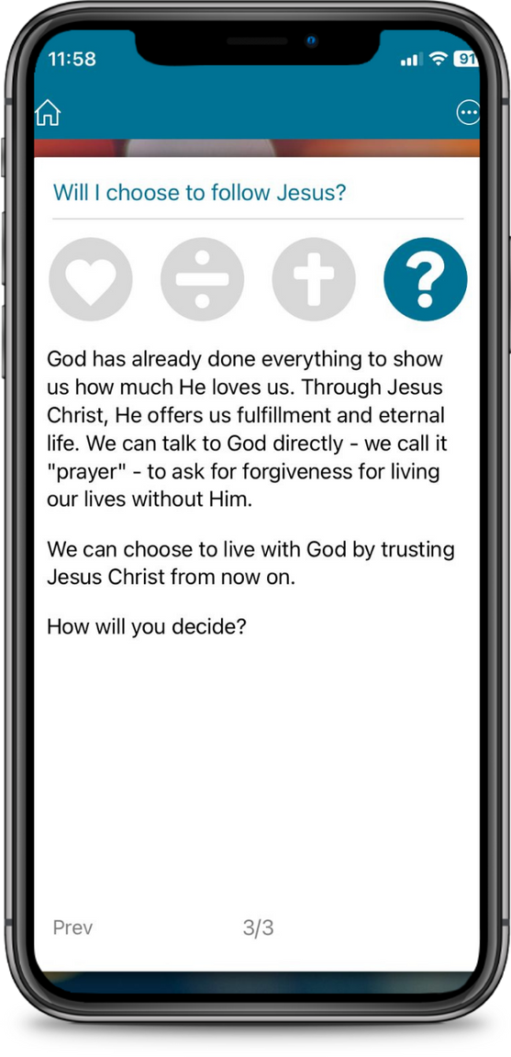
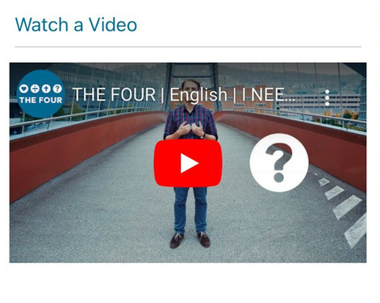

Slide 78



+MENTORSHIP
Pray
It helps to walk accompanied on the path in Grace, in Christ.
+M
Share
Care

Slide 79

IT IS VERY IMPORTANT TO WALK ALONG non-believers
until they grow
in their personal relationship
with Christ

Slide 80
FOUR CRUCIAL POINTS
Pray
MENTORSHIP
+M
+
+
Share
Relationships
of friendship
Accompaniment
Care
+
+
Inspiring Example
Bible-based
discipleship

Slide 81
FRIENDLY RELATIONSHIPS
Take scheduled times
Show appreciation with details
Exchange expectations
Pray
+M
Share
Care

Slide 82

Inspirational example
+Devotionals
+Enseñar a compartir
+Talk about challenges

Slide 83



Bible-based discipleship
Read
Study
Practice

Slide 84
VISIT OUR WEBSITE
www.evangelismoglobal.org

